Slide 1

Pick-a-book
Book store
Tools:
XAMMP,
PHP,
BootStrap-4,
CSS-3

Slide 2
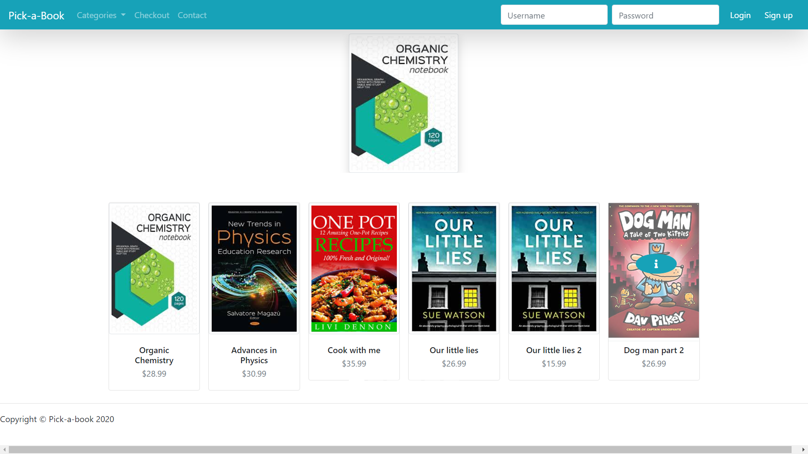
Books as carrousel
Home page
Available books

Slide 3
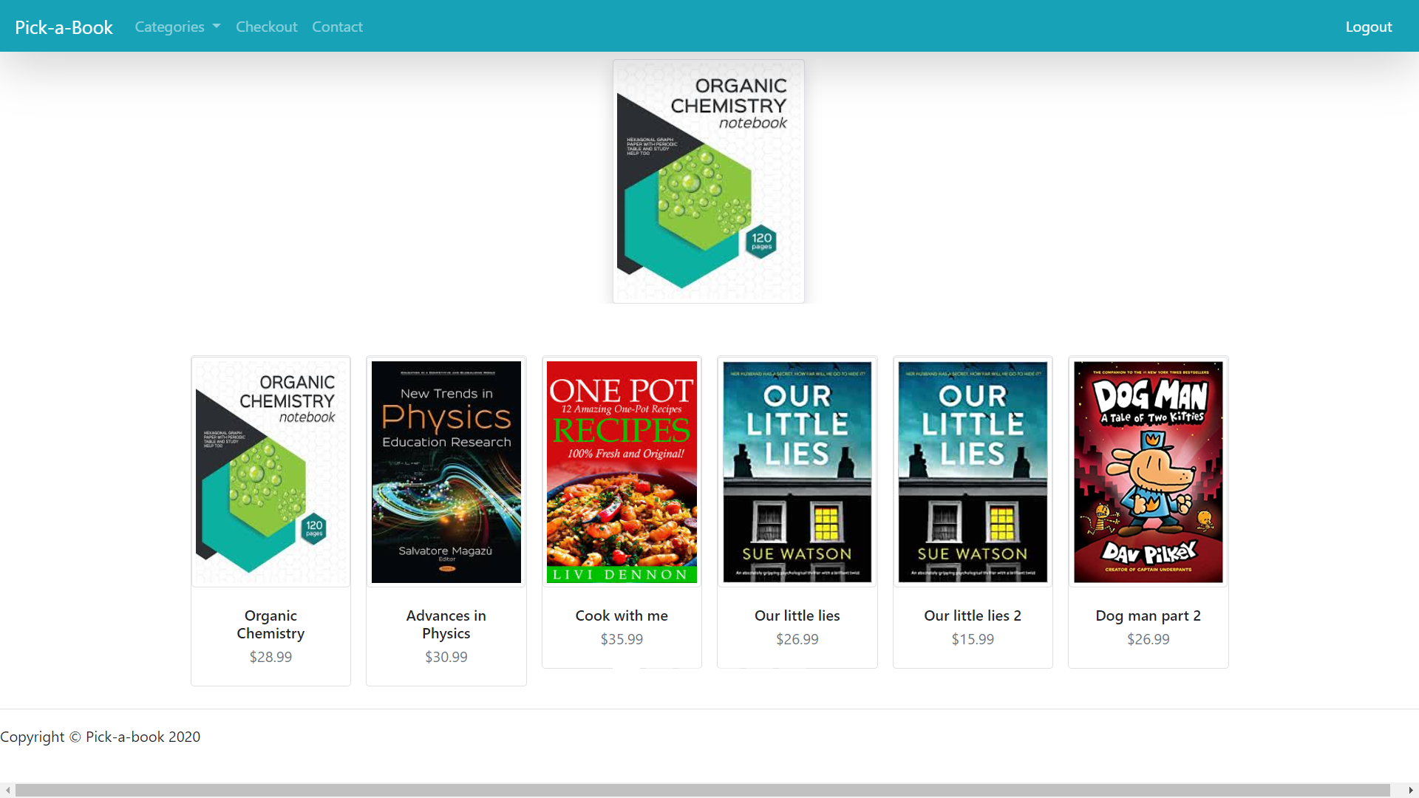
User logged in and redirected to home page

Slide 4
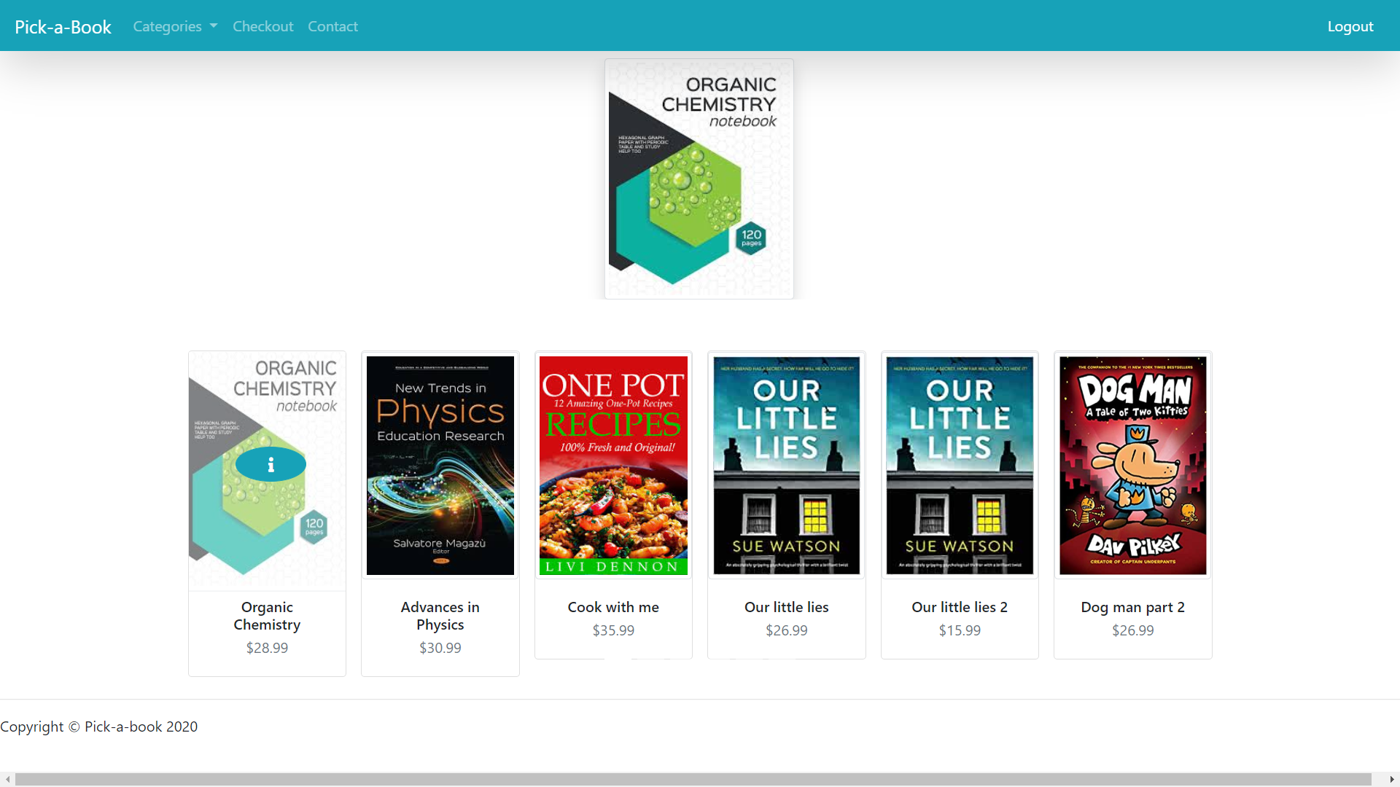
Link to detail view of books

Slide 5
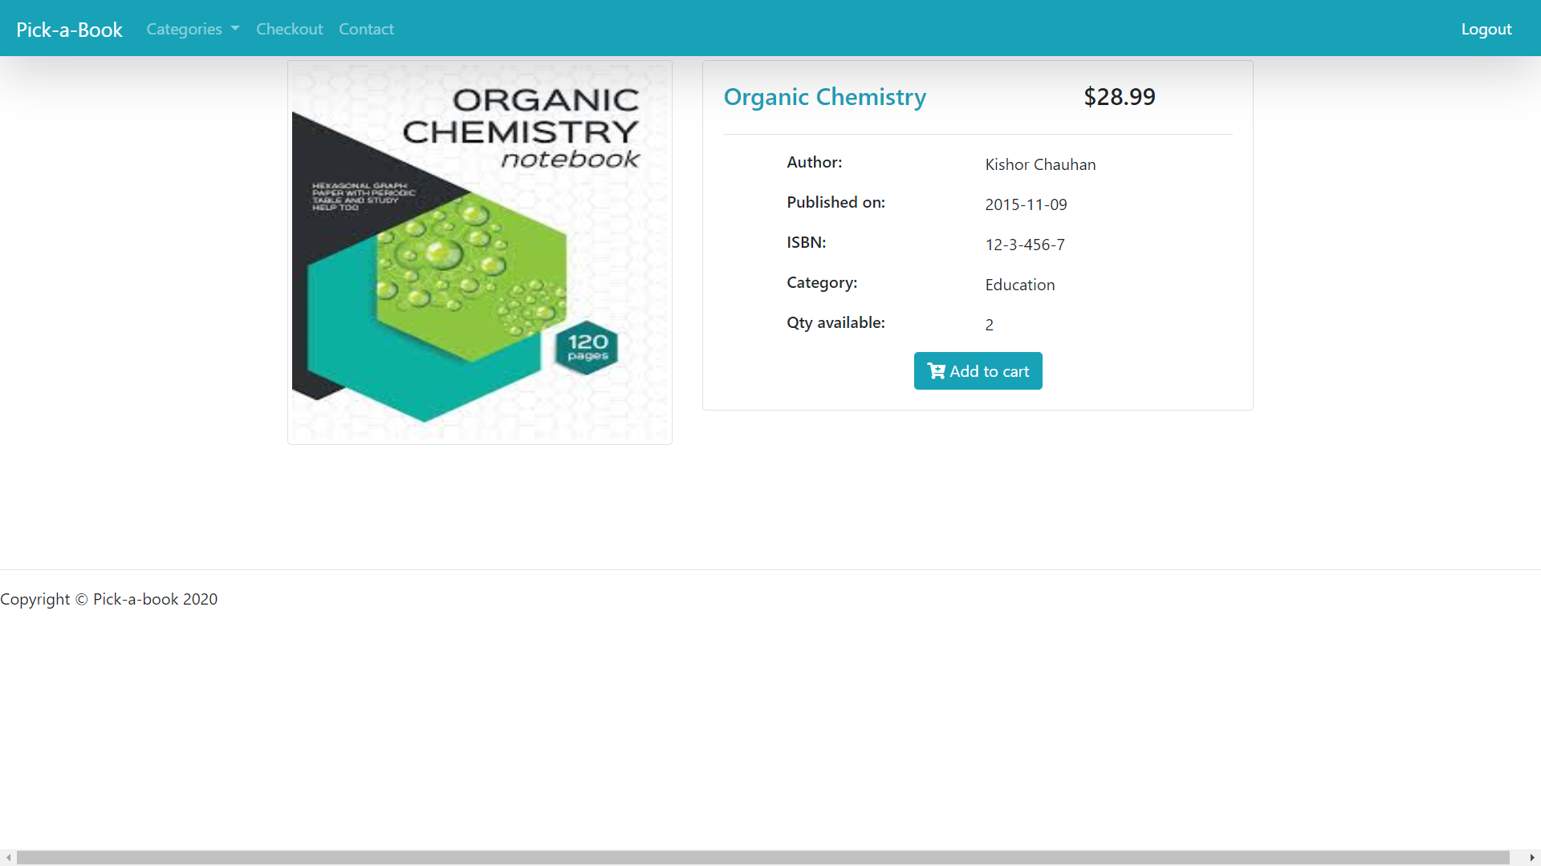
Book detail page
Book can be added to the cart

Slide 6
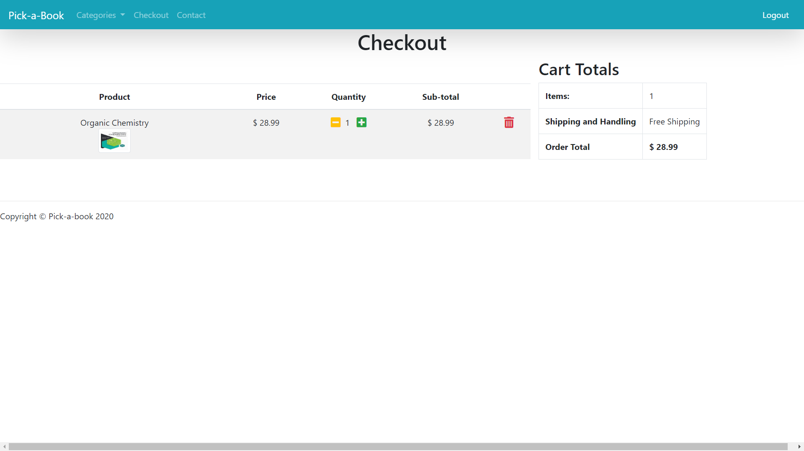
Cart page showing product added and total price

Slide 7

Product quantity can be changed and gets reflected in subtotal, item and order total

Slide 8
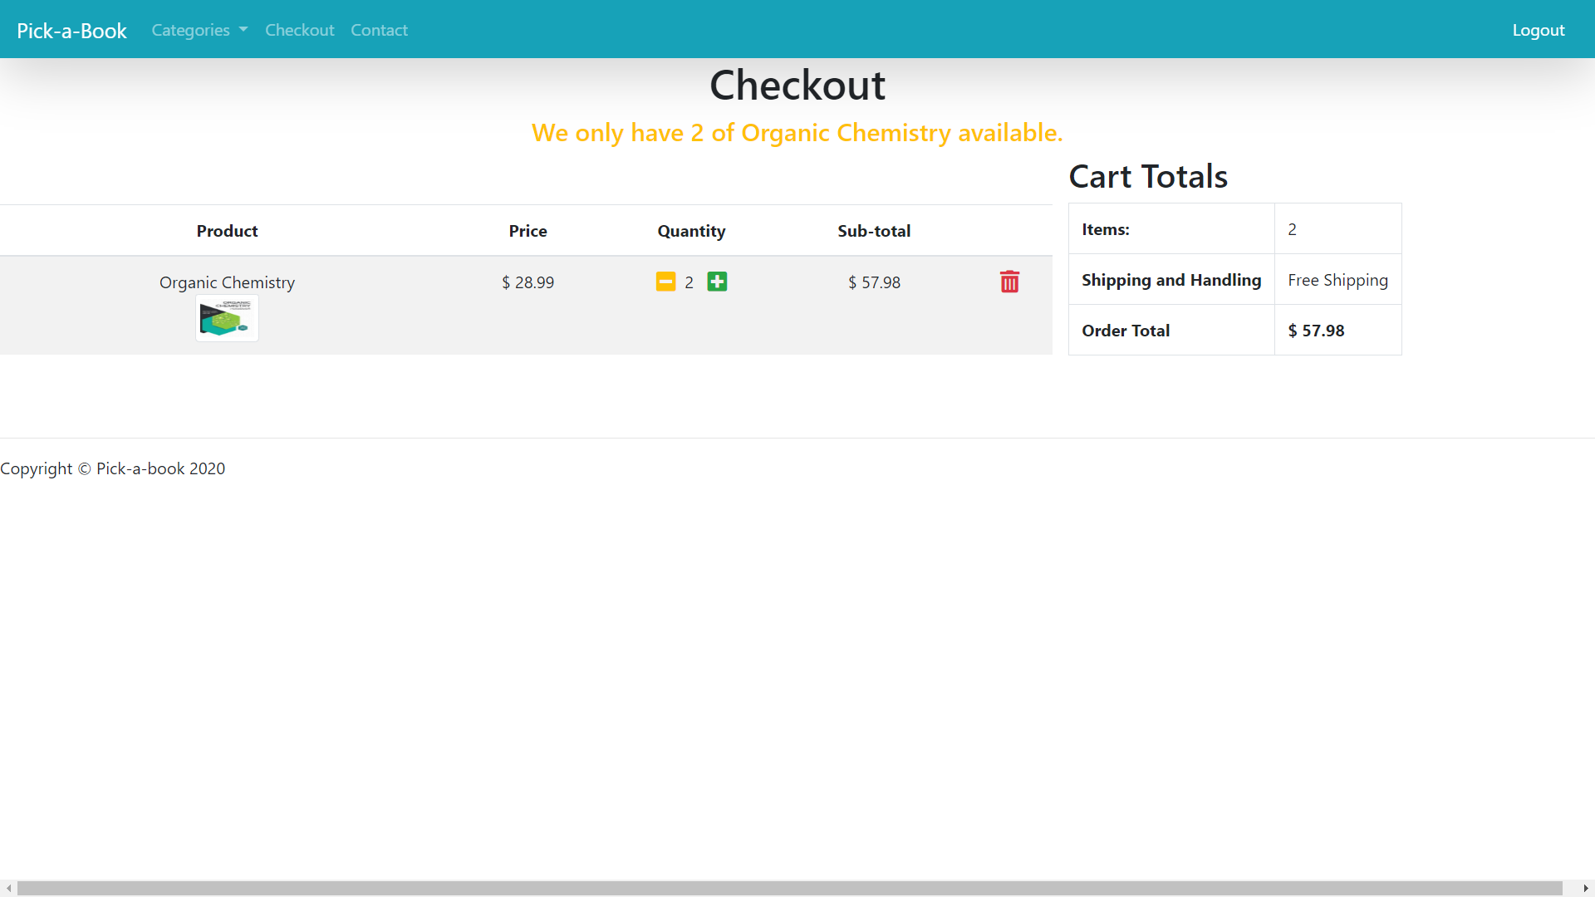
Quantity can not be added more than quantity available

Slide 9
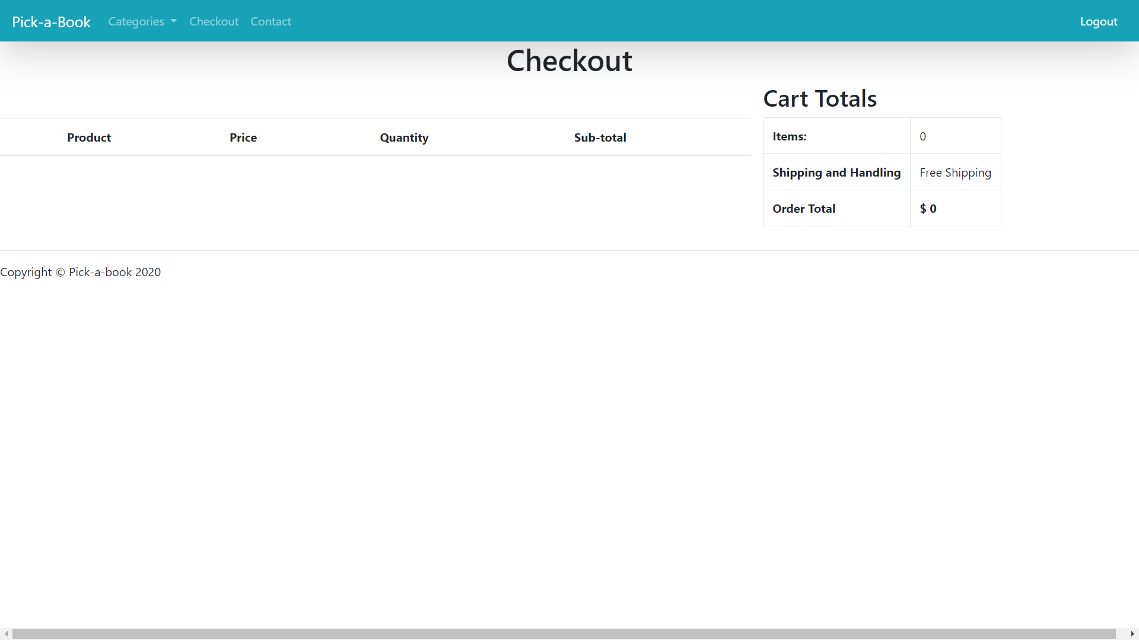
Cart will be empty if no product is added or deleted

Slide 10

Category dropdown

Slide 11
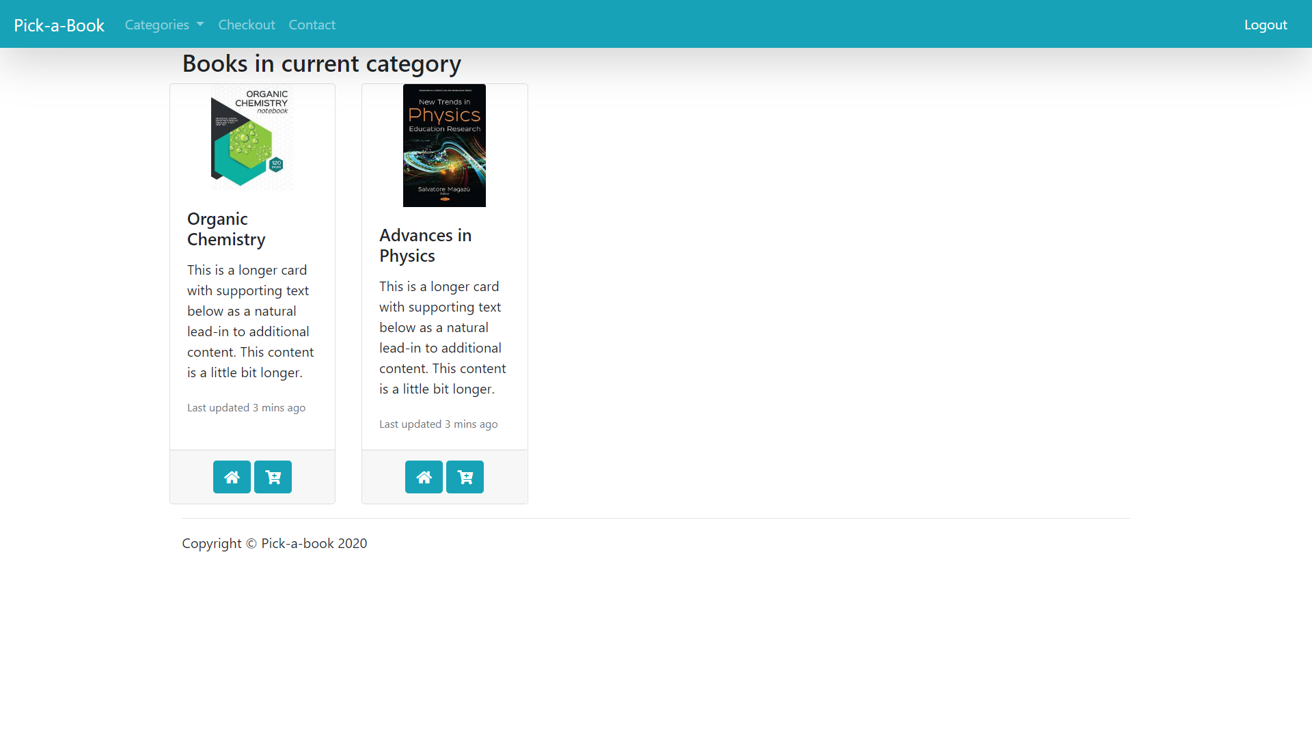
Displays books available in selected category

Slide 12
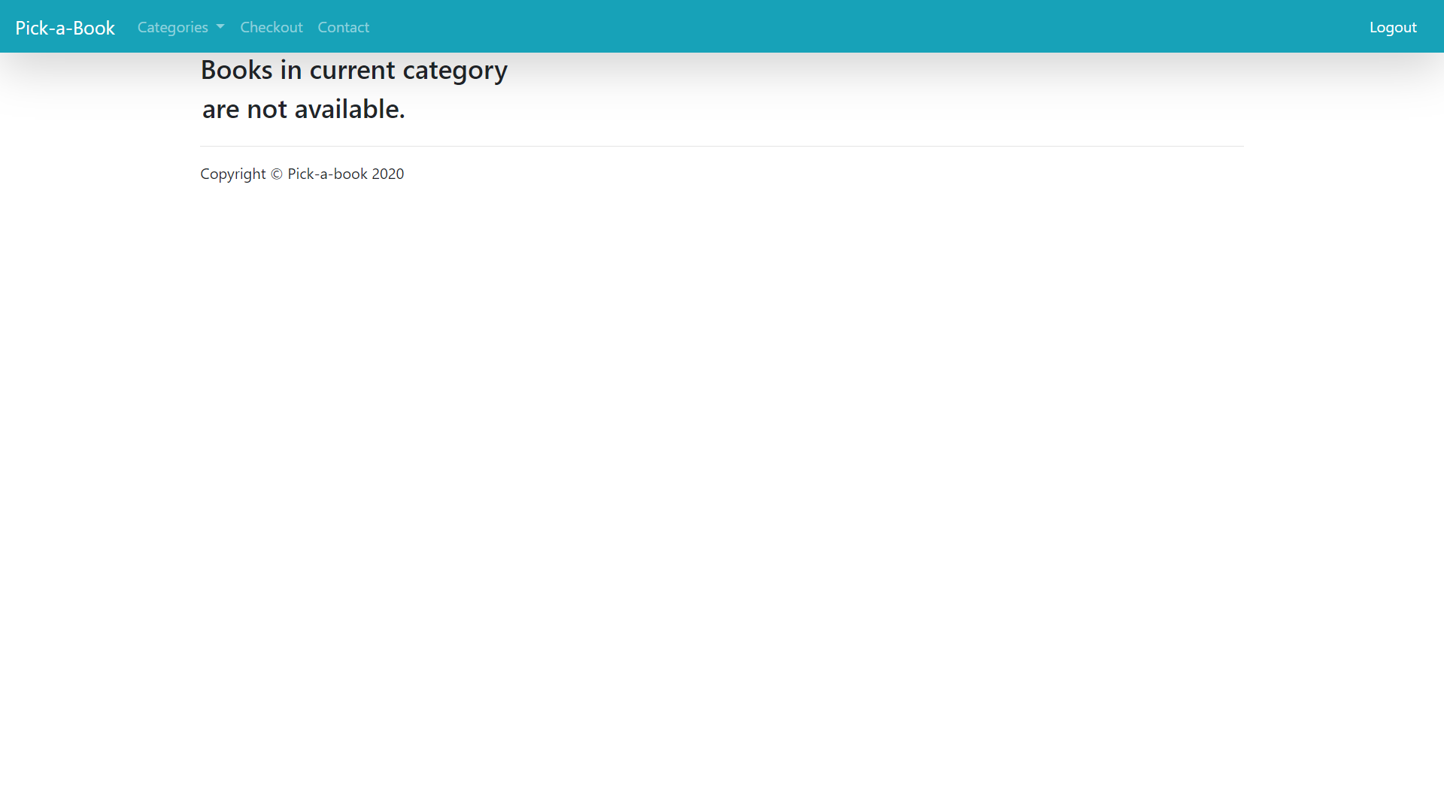
No books available in selected category

Slide 13
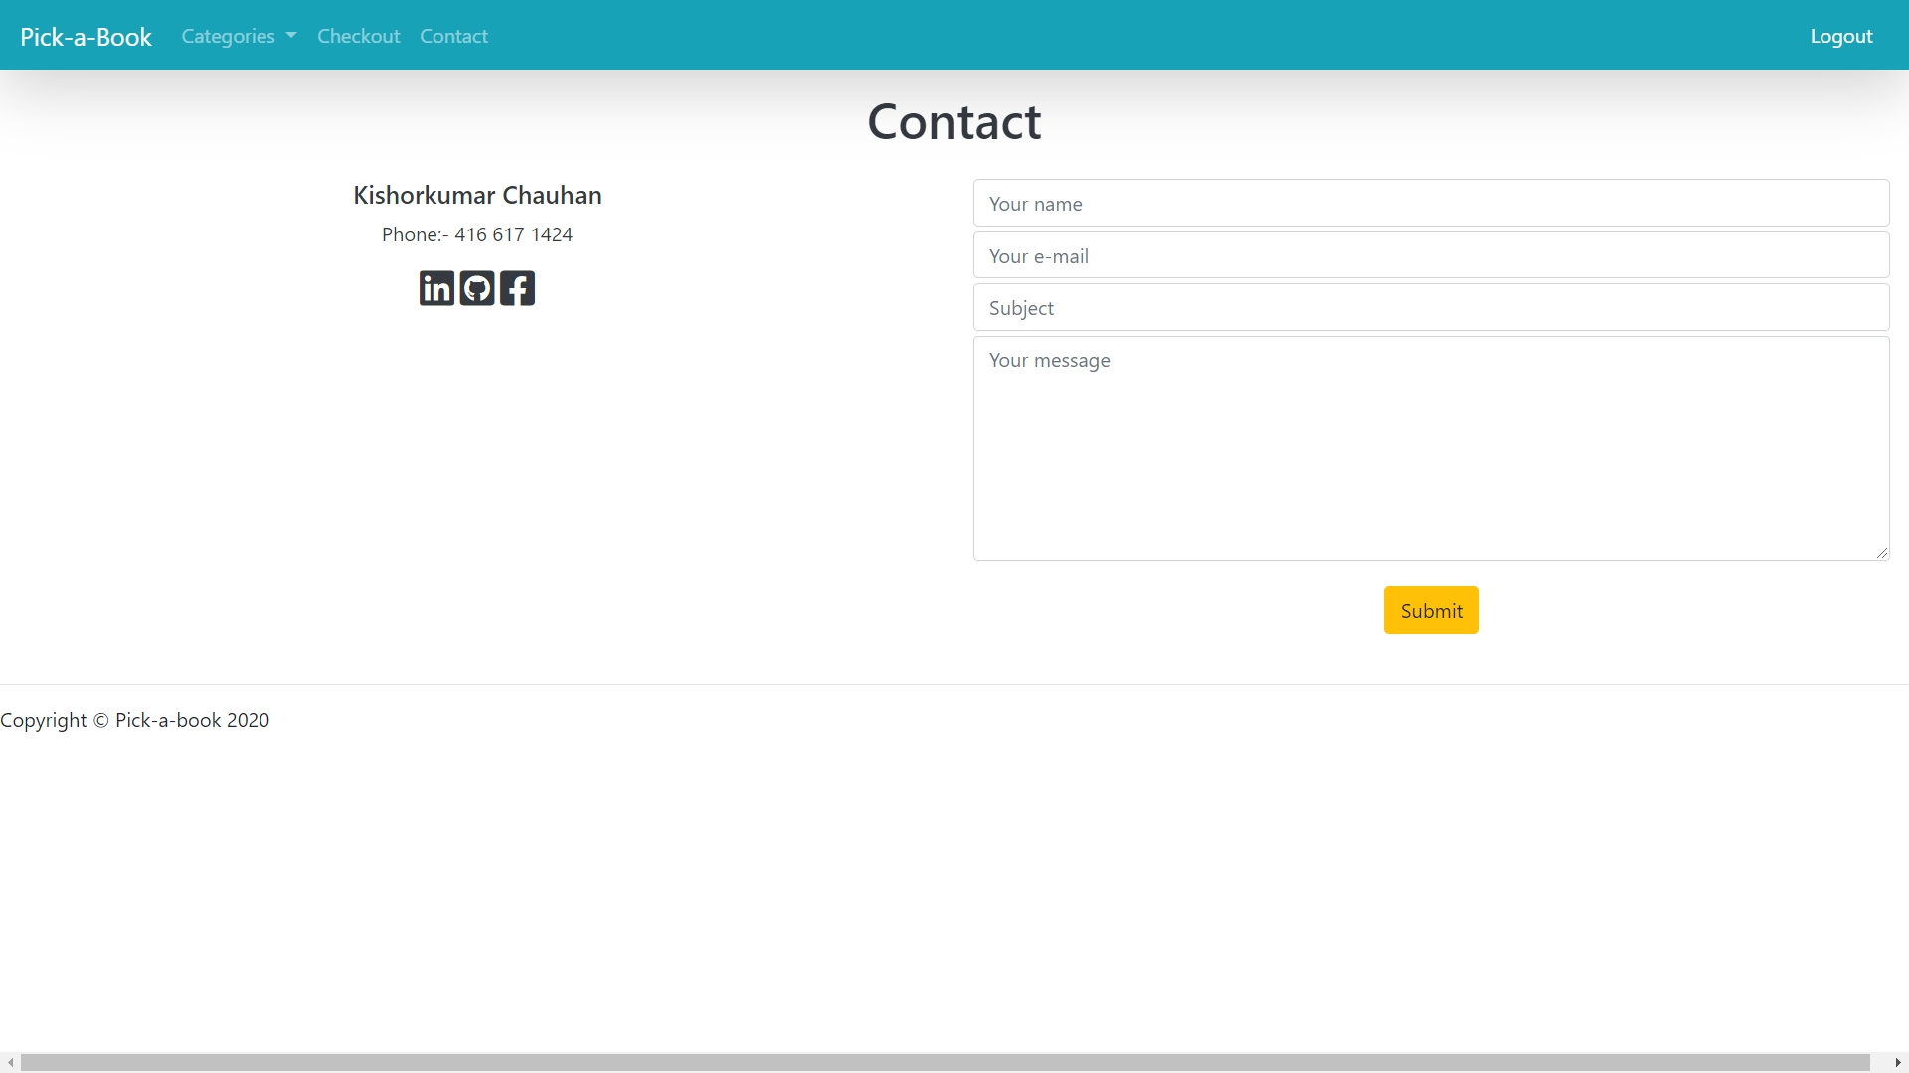
Contact page

Slide 14
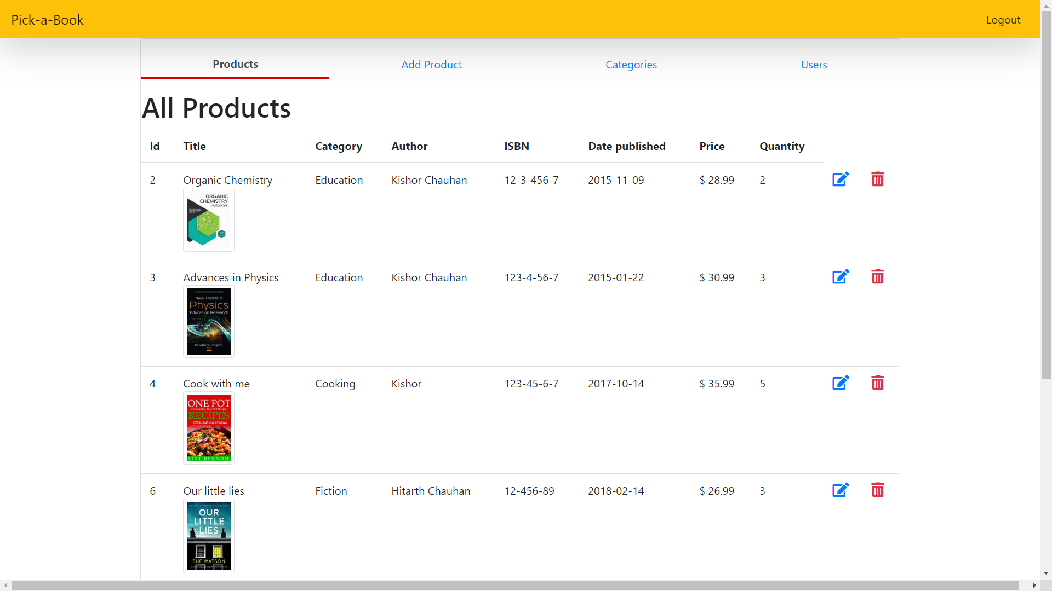
Admin page

Slide 15
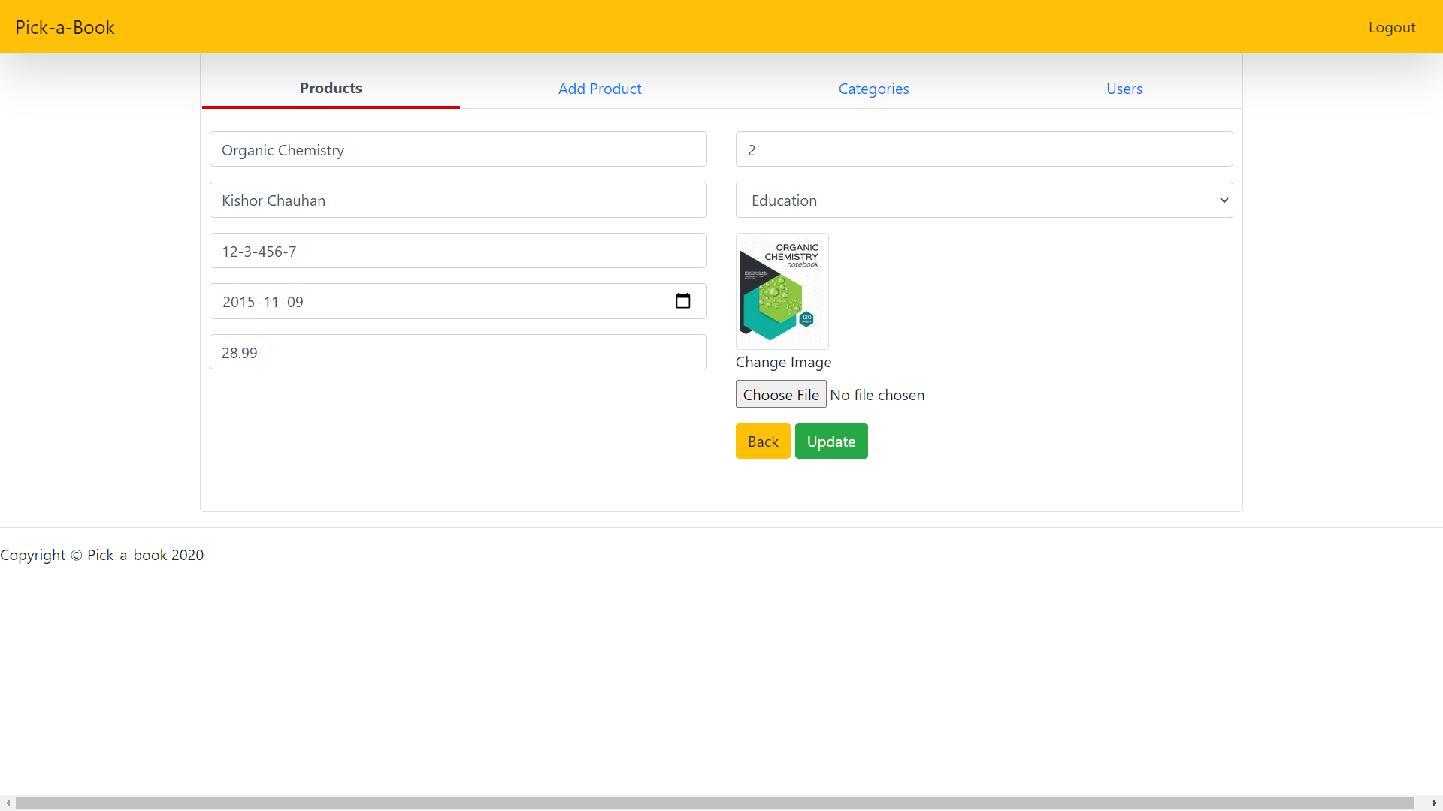
Books can be updated

Slide 16
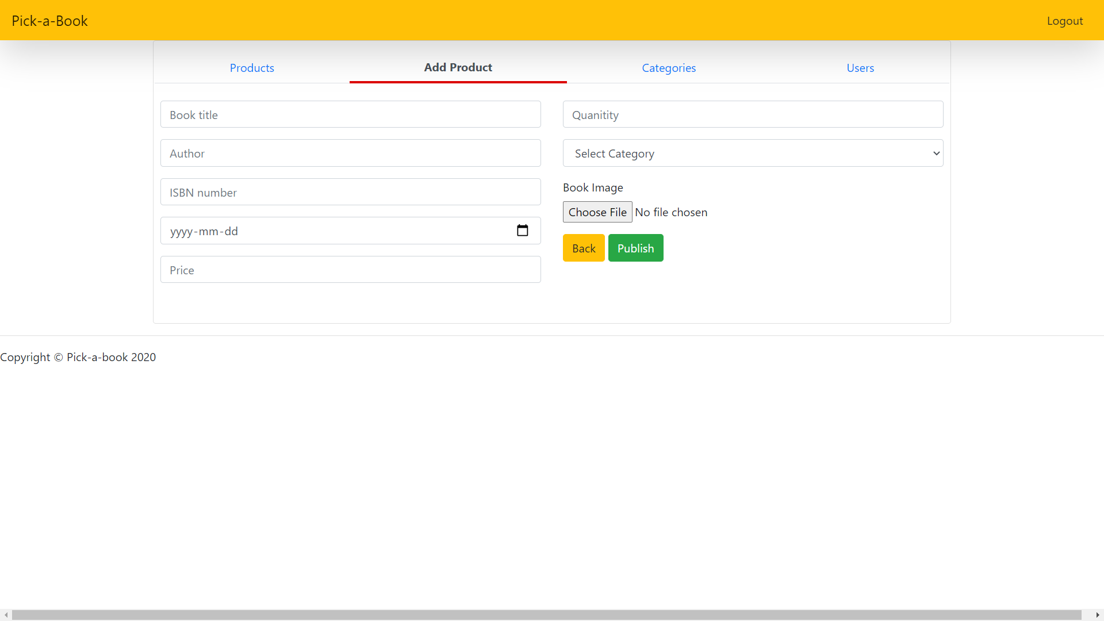
Page to add a new book to the store

Slide 17
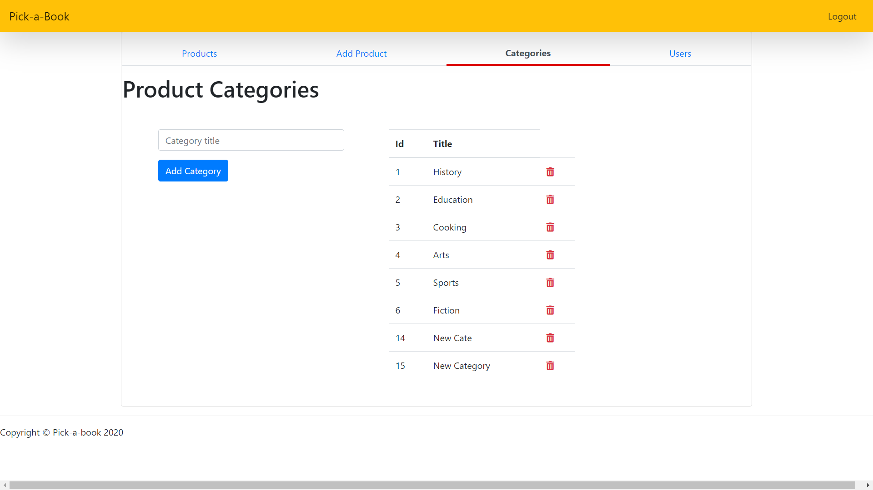
Page to add a new category of book

Slide 18
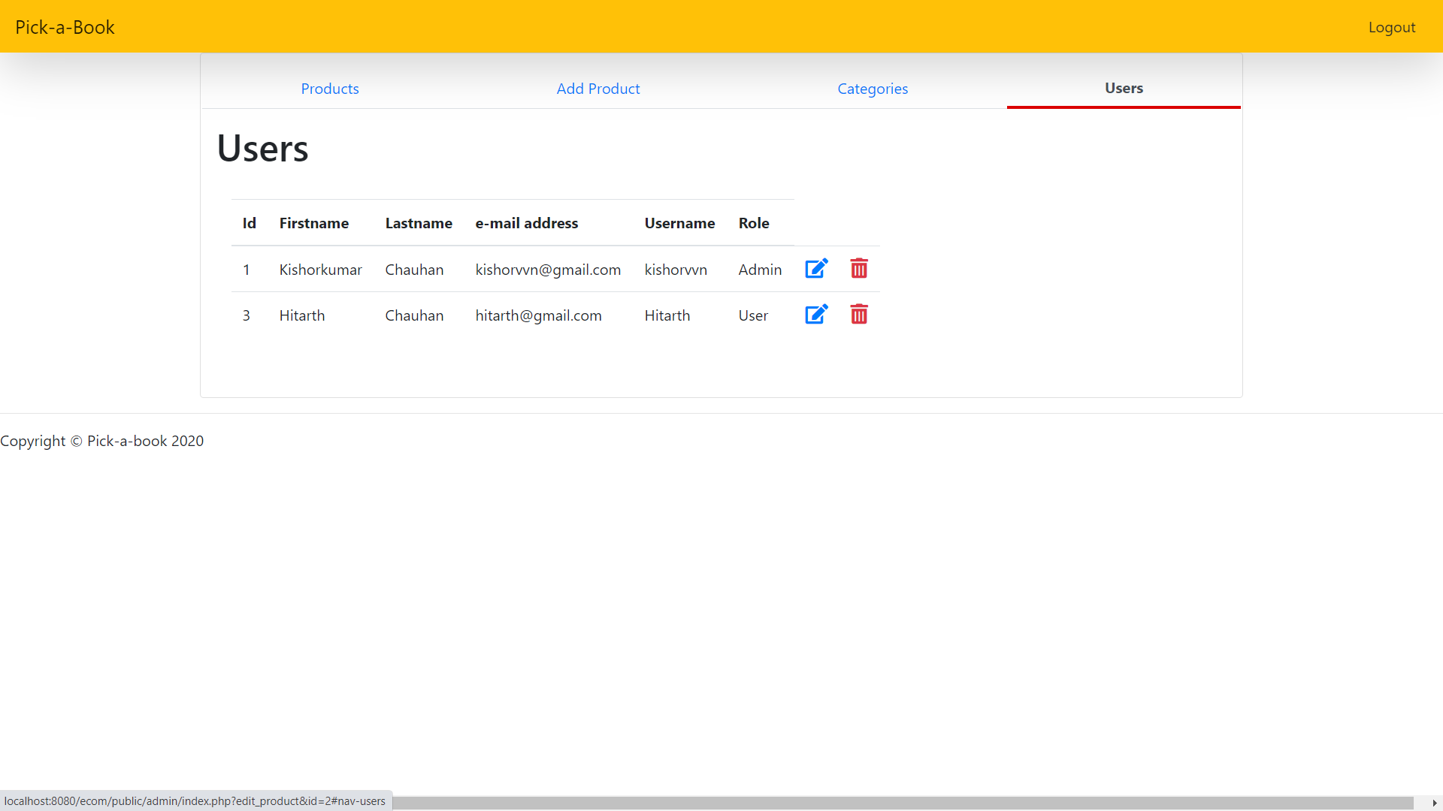
Users management page

Slide 19
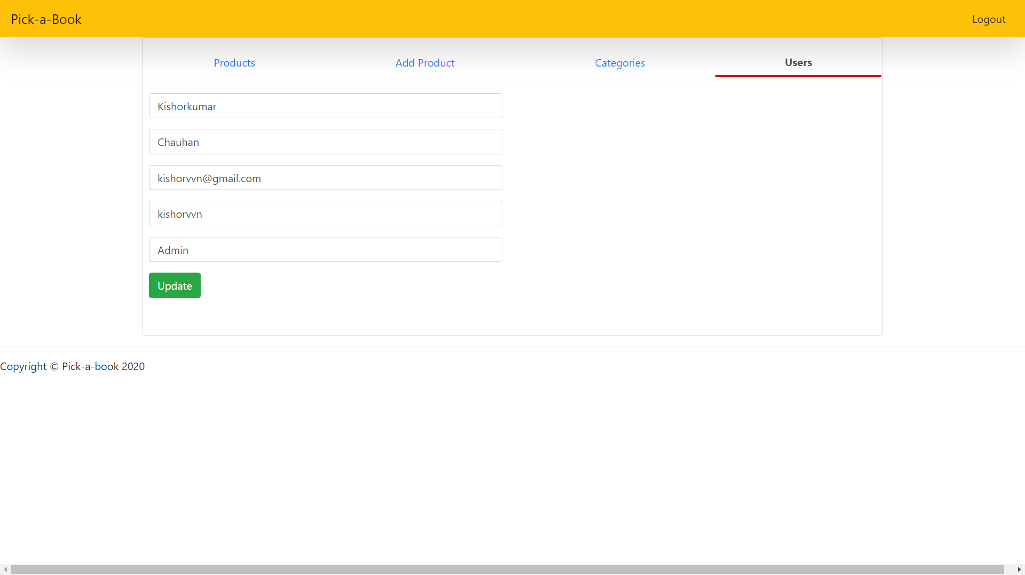
Page to update user

