Slide 1

My Weather App
Built using UWP on Windows 10

Slide 2
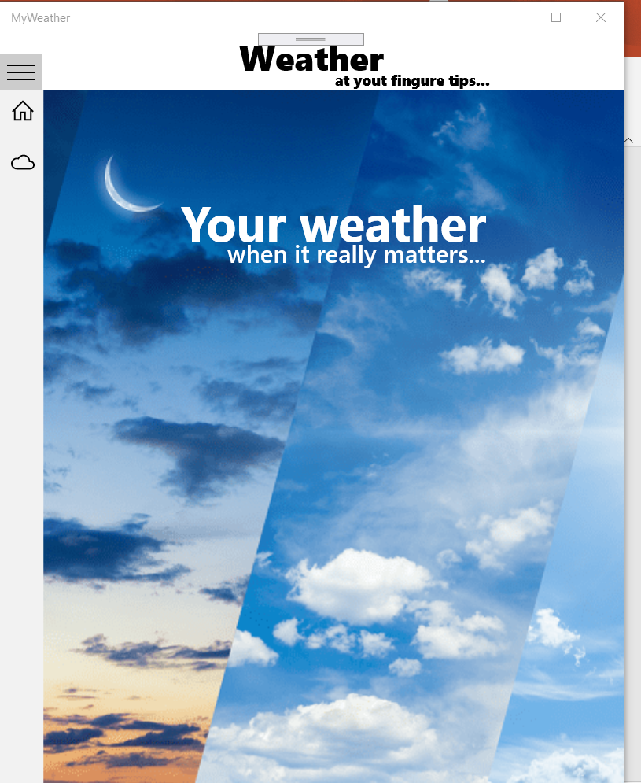
Home page

Slide 3
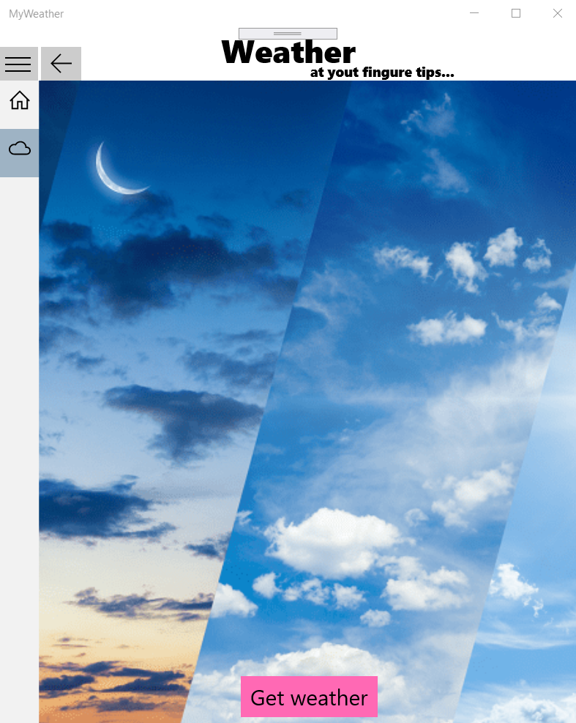
Weather page

Slide 4
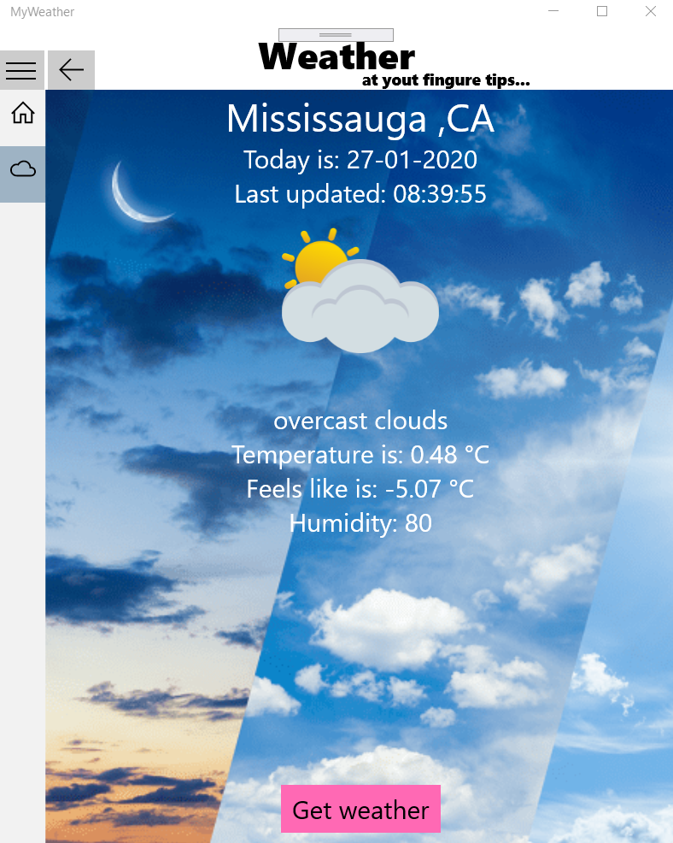
Get weather
Button clicked

Slide 5
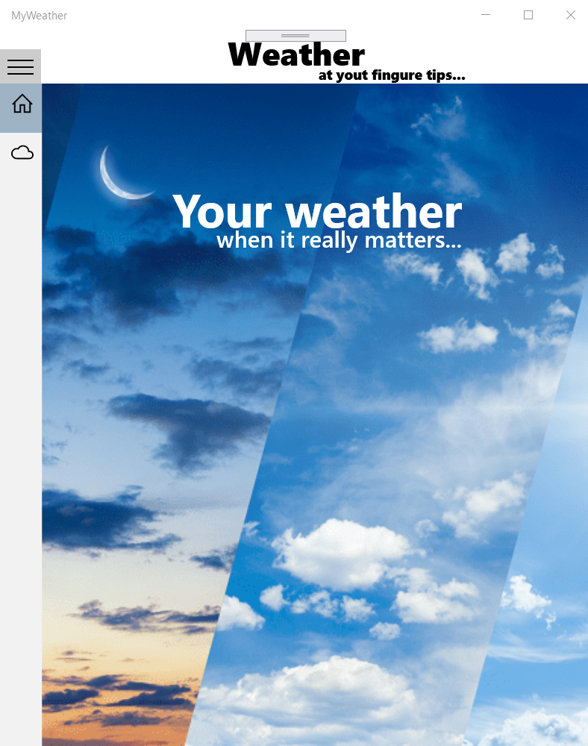
Back button
clicked

