Slide 1
Website for Papa’s Kitchen
Created as final project in
C# and ASP.NET module

Slide 2
Prototype

Slide 3
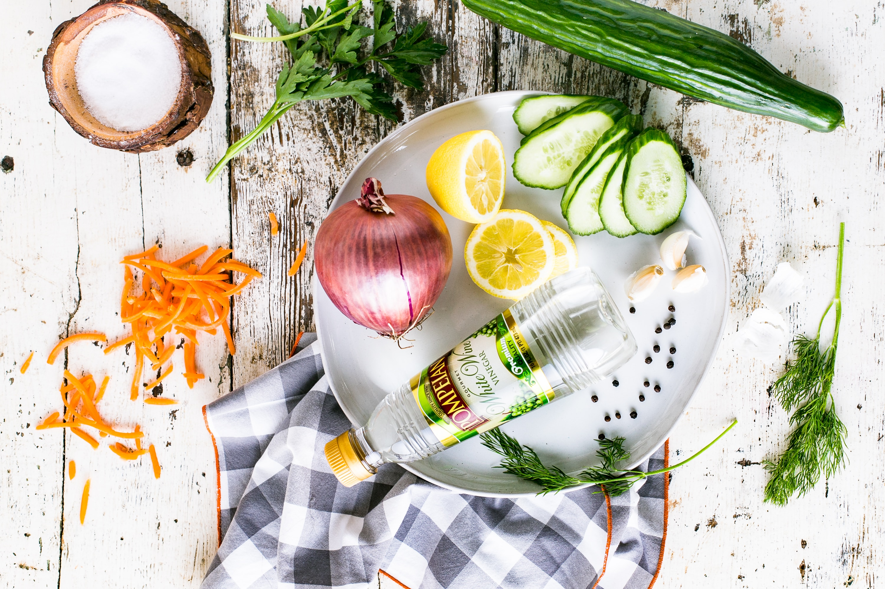
Papa’s Kitchen
Where food is served with love

Slide 4
Objectives of project:
To display an object or database in html/CSS/java script (bootstrap) using ADO.NET, Entity Framework, MVC (Model View Controllers) in a ASP.NET format.
User will be able to add, edit delete data.

Slide 5
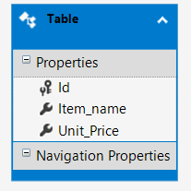
Data sets and UML diagram:
ID of an item, int datatype, Primary key
Item name, nchar(50) datatype
Unit price, money datatype

Slide 6
Home Page layout……..
Papa’s Kitchen
Home
About Us
Contact Us
Items
Papa’s Kitchen
.....Where food is served with Love
Other sister branches……..
Nilgiris…
Famous for it’s soft and delicious idlis, The Nilgiris has been serving love and homely food since 2001. We started off as a take-out and catering facility till November 2007 after which we decided to open doors to our humble restaurant. Our specialities include all varieties of dosa, idly, uthappam, biryani, Thali, sweets and snacks.
Guru Lakshmi…
After searching for an Authentic South Indian Restaurant, we realized that Canada was deprived of it. So we decided to open just that, an Authentic South Indian Restaurant with personal touch and care paid to our unbeatable taste and customer service
Dal Roti…
We are committed to serving the very best in Indian cuisine. Featuring only the finest, freshest ingredients, each dish is delicately prepared to highlight the robust flavors of the Bombay region. We hope to see you tonight.

Slide 7
About Us
Page layout…….
Papa’s Kitchen is known for its innovation and yet maintaining the original flavors of traditional India with prime focus on quality and affordability. Our rich decade of extensive experience will truly reflect in our mouth watering taste and excellent services. Customer satisfaction is religion to Papa’s Kitchen and that is what has kept us growing and preserve the century old custom alive. Our preparation is not only meant to satisfy the Indian palate but also assure international standards.
Hygiene is our top most priority.

Slide 8
Contact Us
Page layout…….
Food Fiesta,
55 City Center Drive,
Mississauga, ON, L5B 1M3
Phone: 416 617 1424
E mail: kishorkumar.chauhan@triosstudent.com

Slide 9
Items
Page layout…….
ID | Item | Unit price
1 | Vegetable Biryani | 8.99
2 | Vegatable pulao | 7.99
3 | Curd rice | 4.5
4 | Paneer Handi | 7.99
5 | Mashroom Masala | 5.99
6 | Tandoori Naan | 2.5
7 | Tandoori Roti | 1.5
Edit
Details
Delete
Edit
Details
Delete
Edit
Details
Delete
Edit
Details
Delete
Edit
Details
Delete
Edit
Details
Delete
Edit
Details
Delete
User will be able to edit and delete items. User can also view details of selected items and it will be possible for user to add item as per required data fields.

Slide 10
Final project

Slide 11
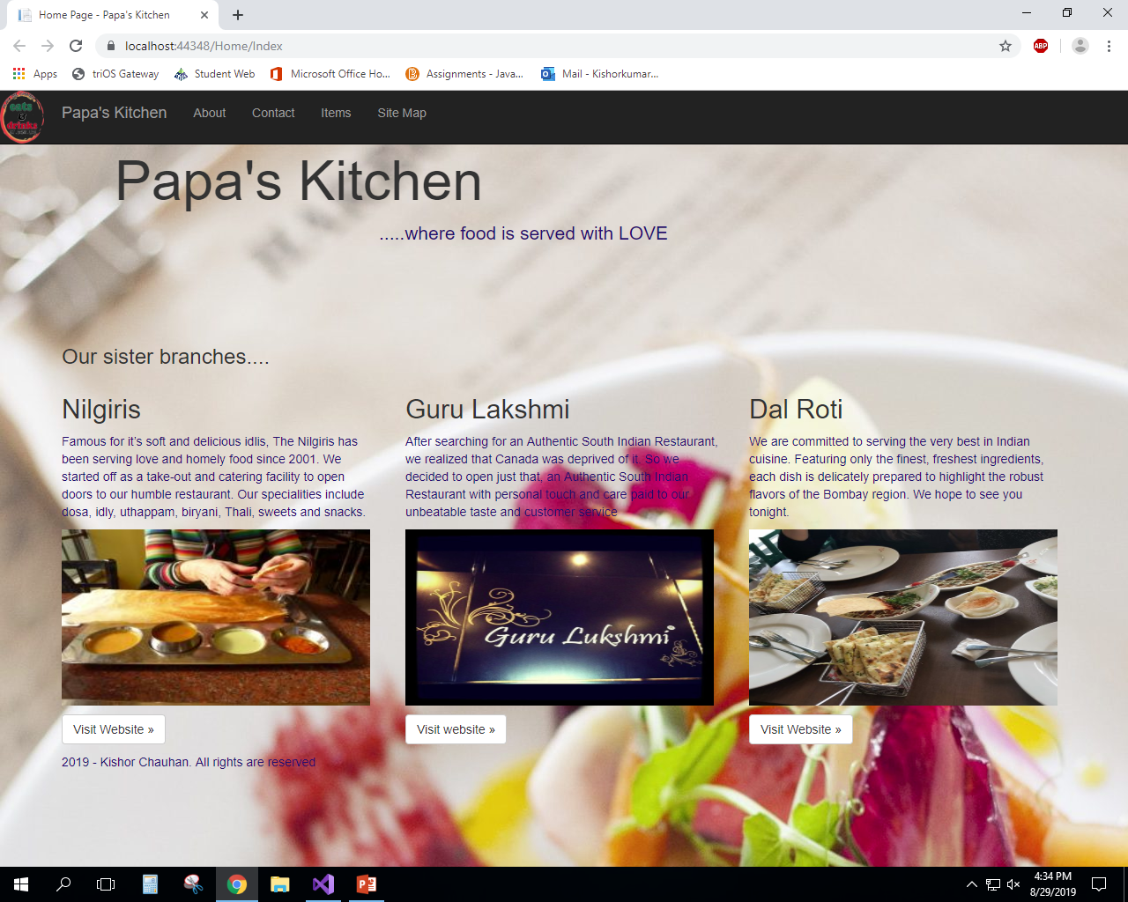

Slide 12
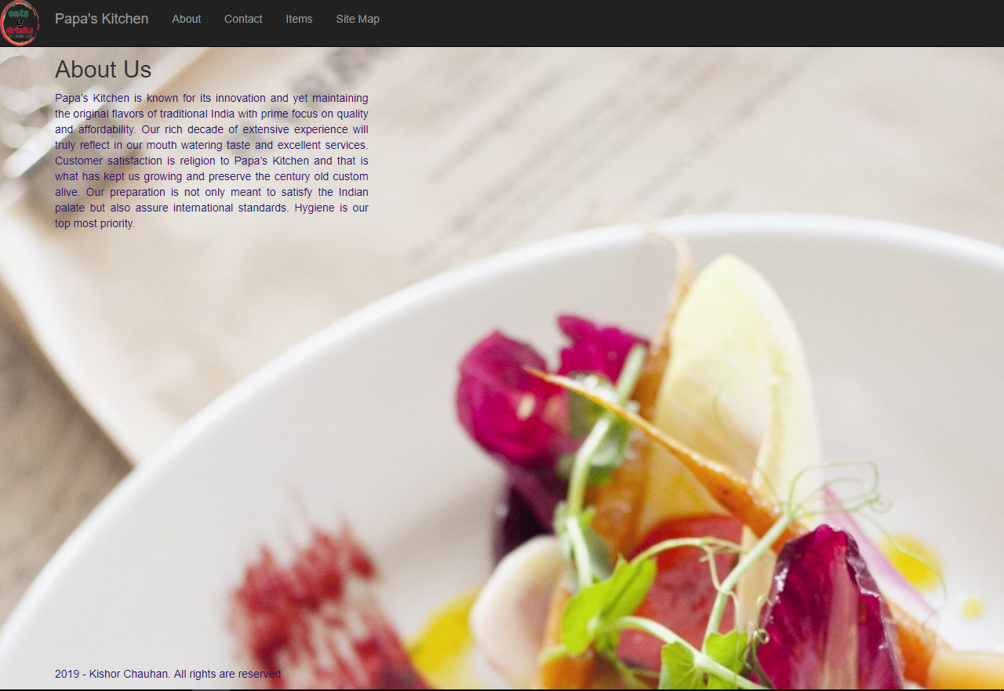

Slide 13
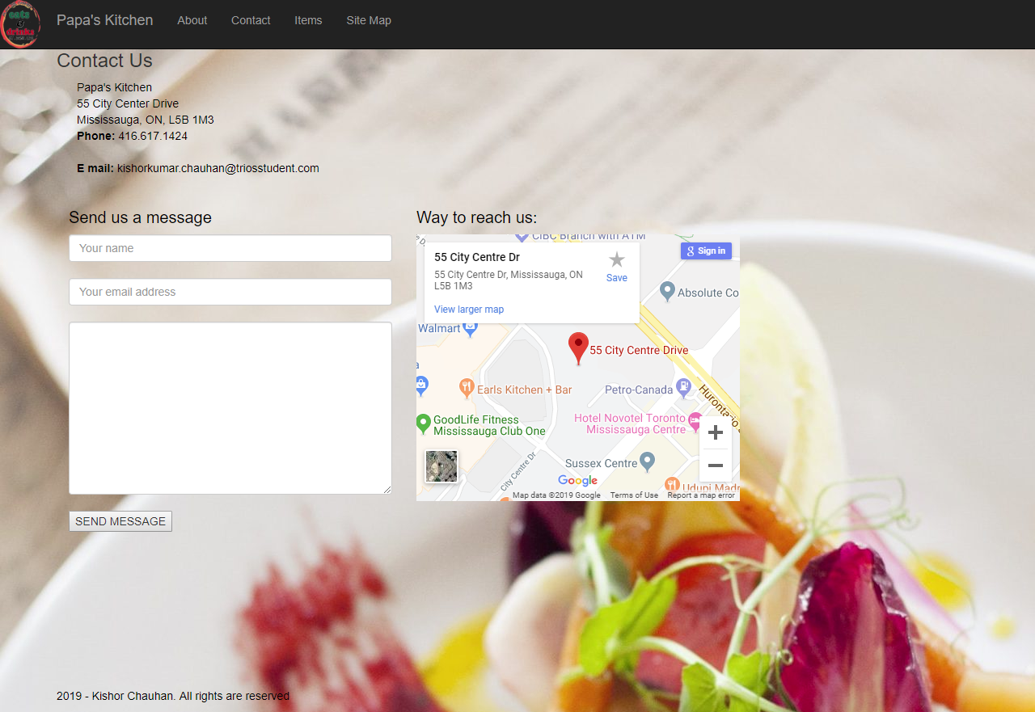

Slide 14
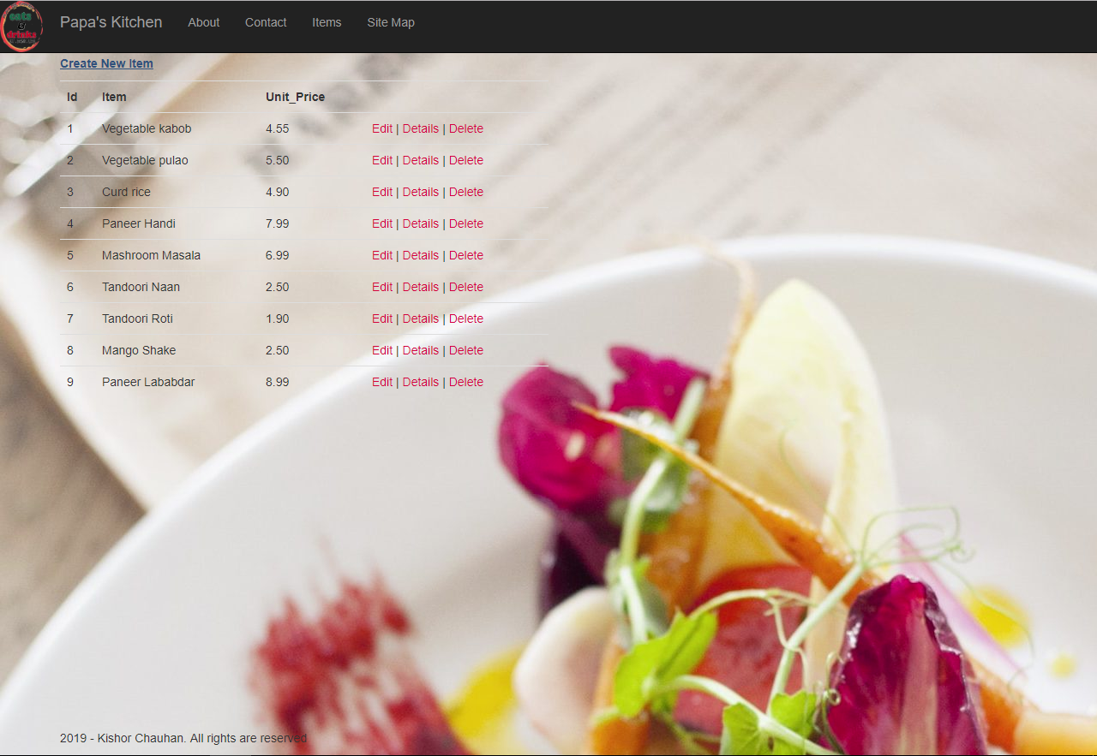

Slide 15
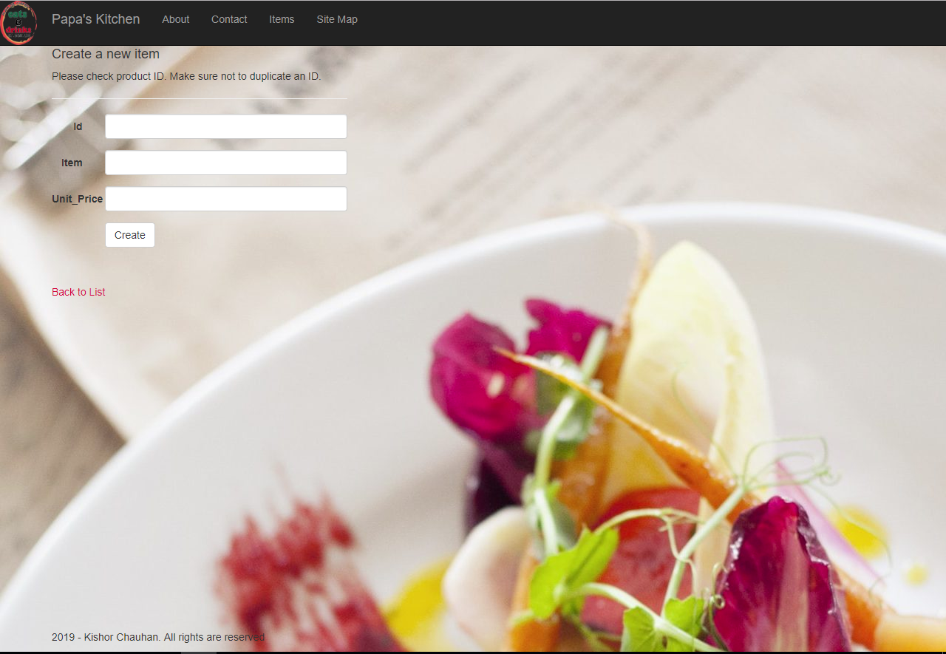

Slide 16
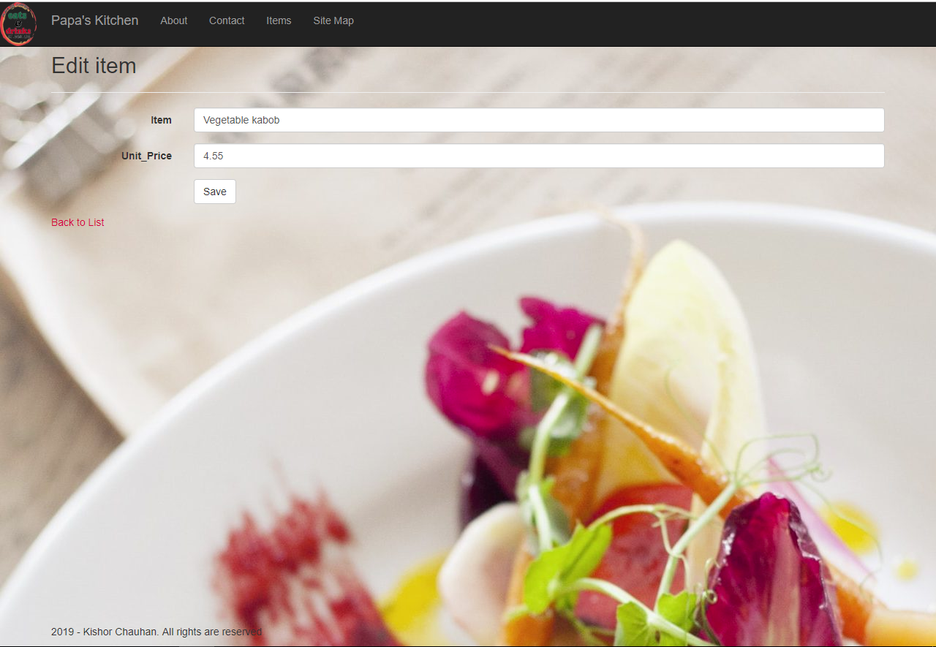

Slide 17
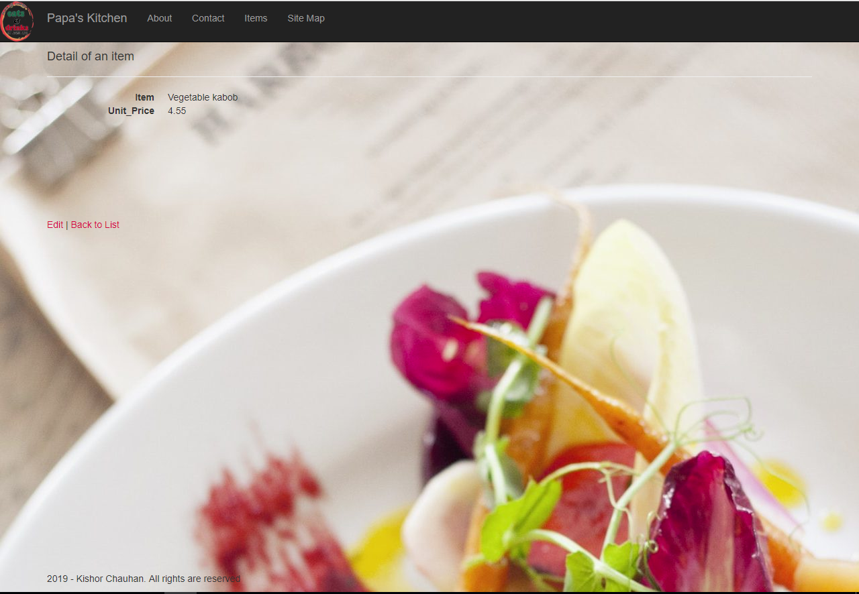

Slide 18
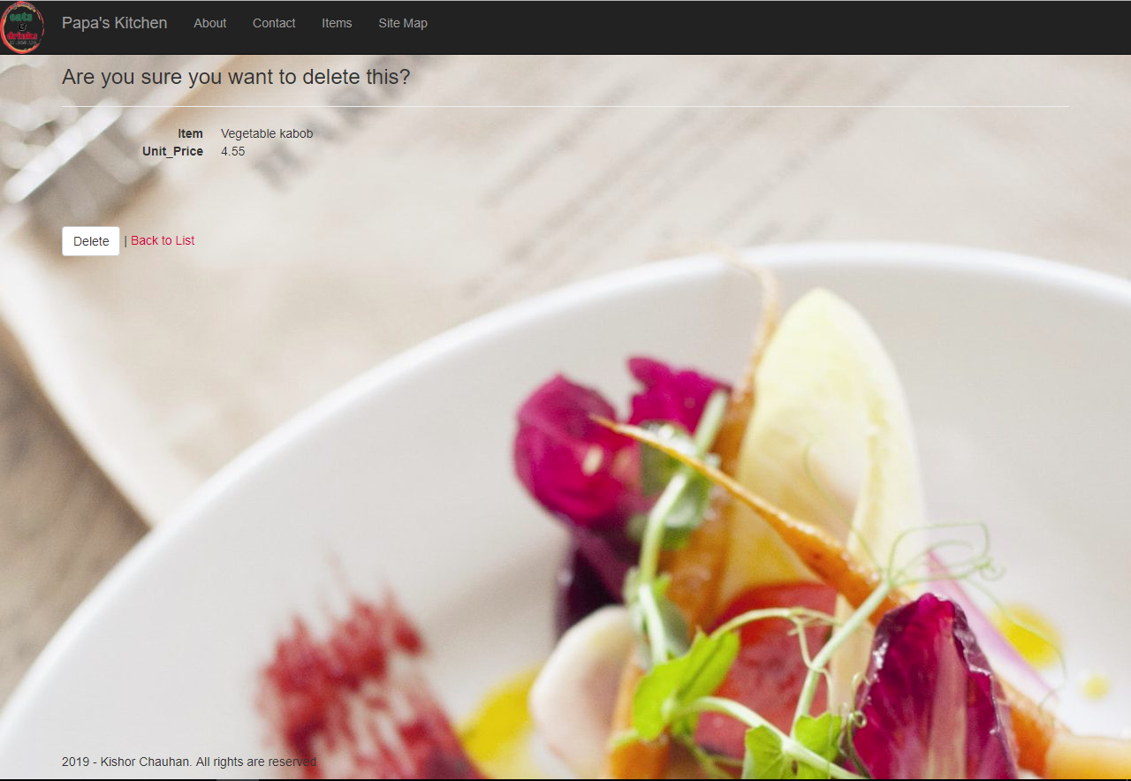

Slide 19
