Slide 1
Project
ADOBE PHOTOSHOP
by - Kishorkumar Chauhan

Slide 2


Slide 3
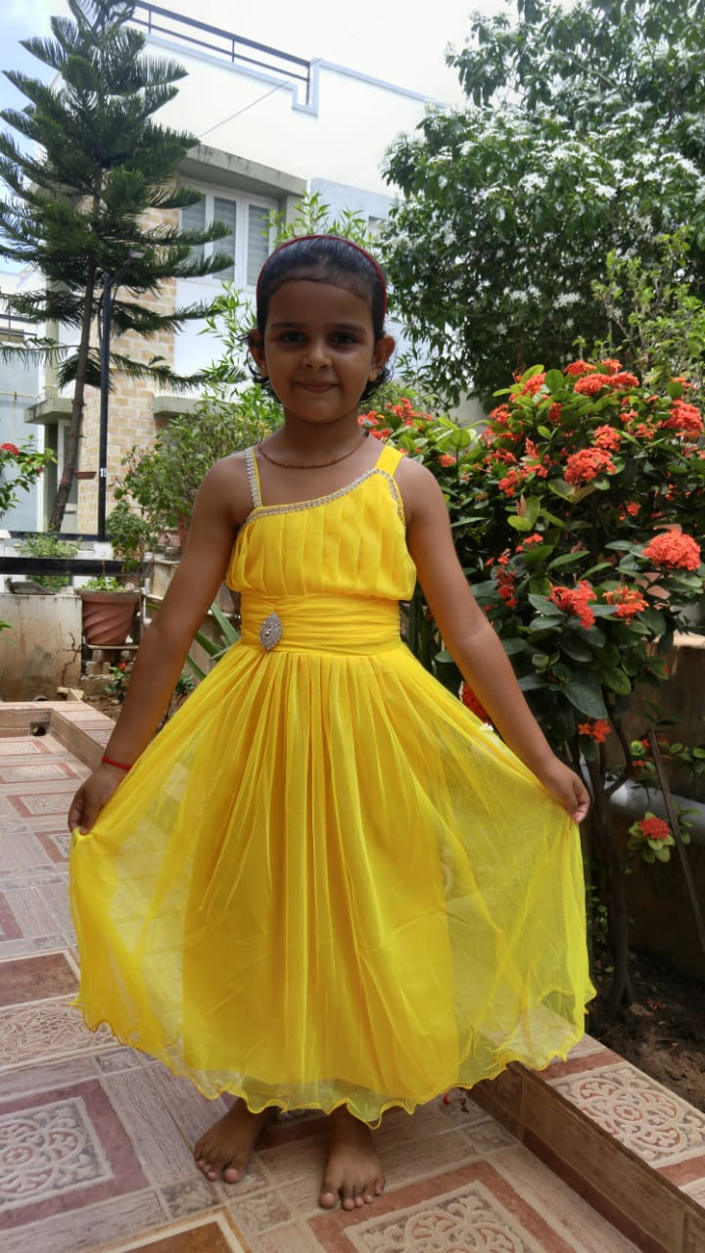
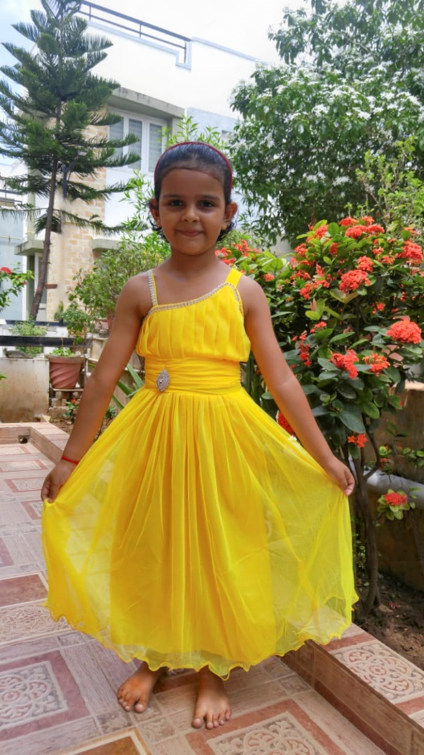
Before
After

Slide 4


Slide 5
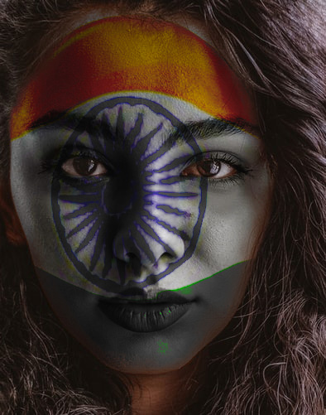

Slide 6


Slide 7


Slide 8


Before
After

Slide 9
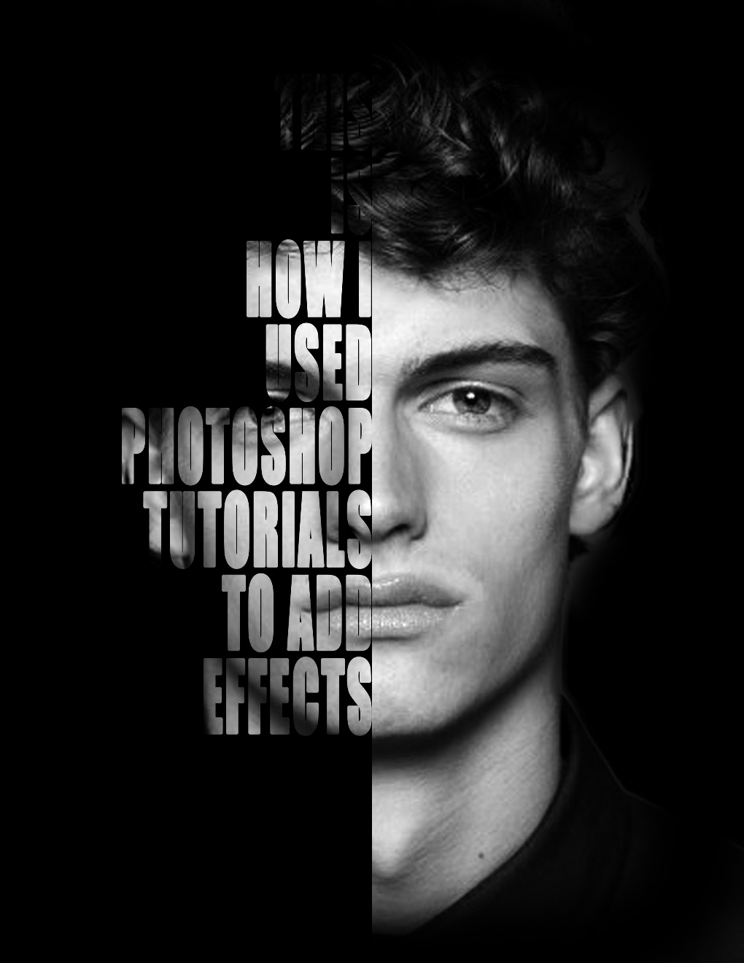

Slide 10


Slide 11


Slide 12


