Slide 1
PICK-A-BOOK Book Store
Final project

Slide 2
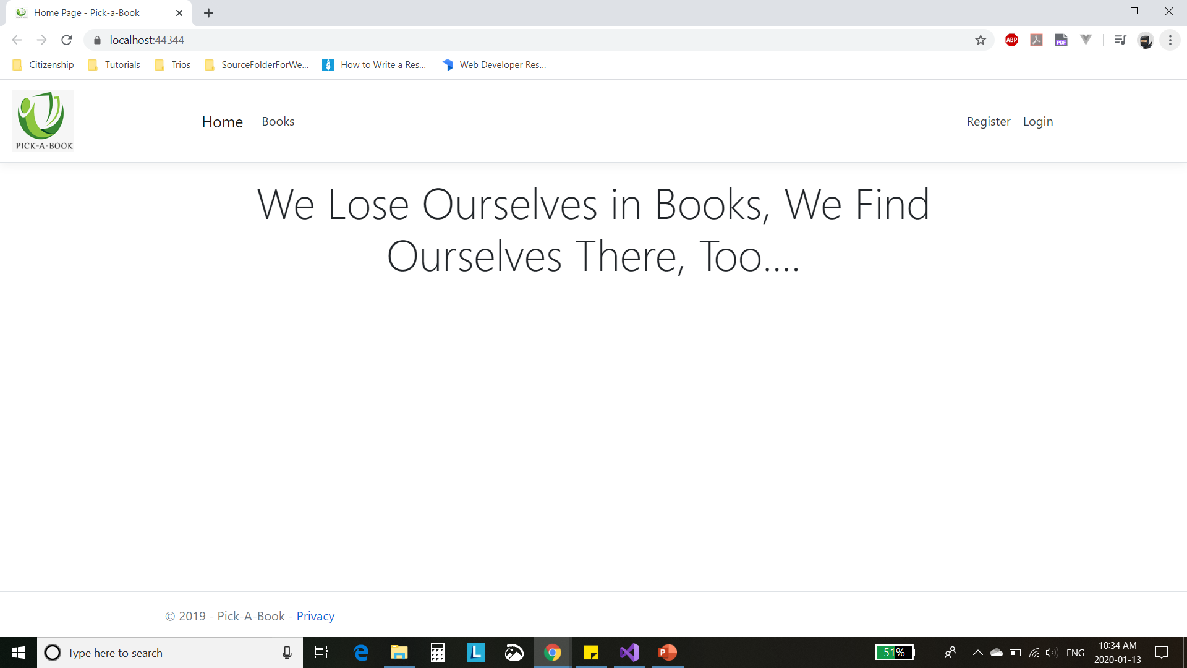
Home page

Slide 3
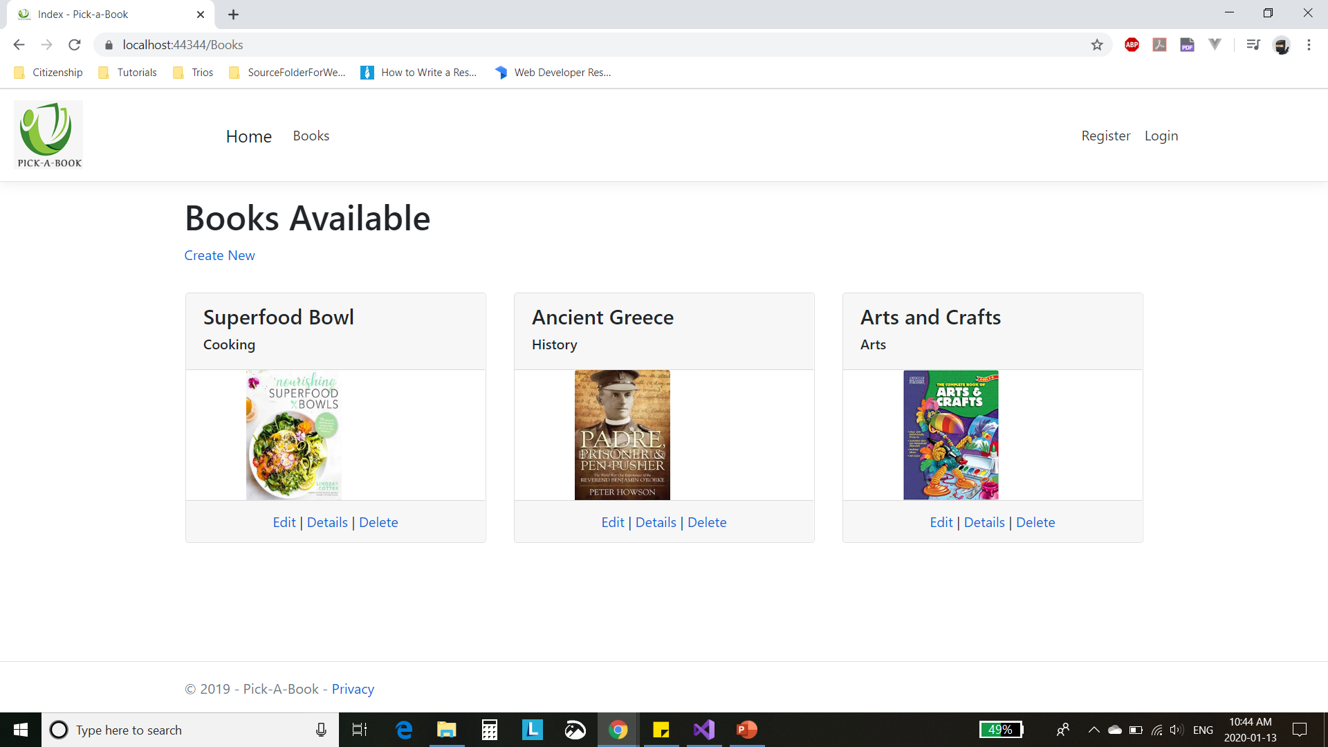
Books page

Slide 4
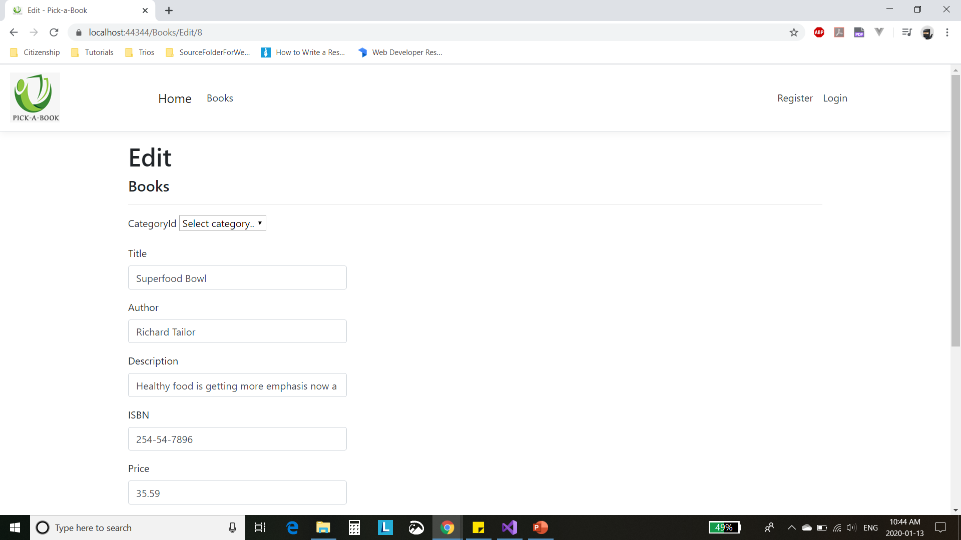
Edit page First half

Slide 5
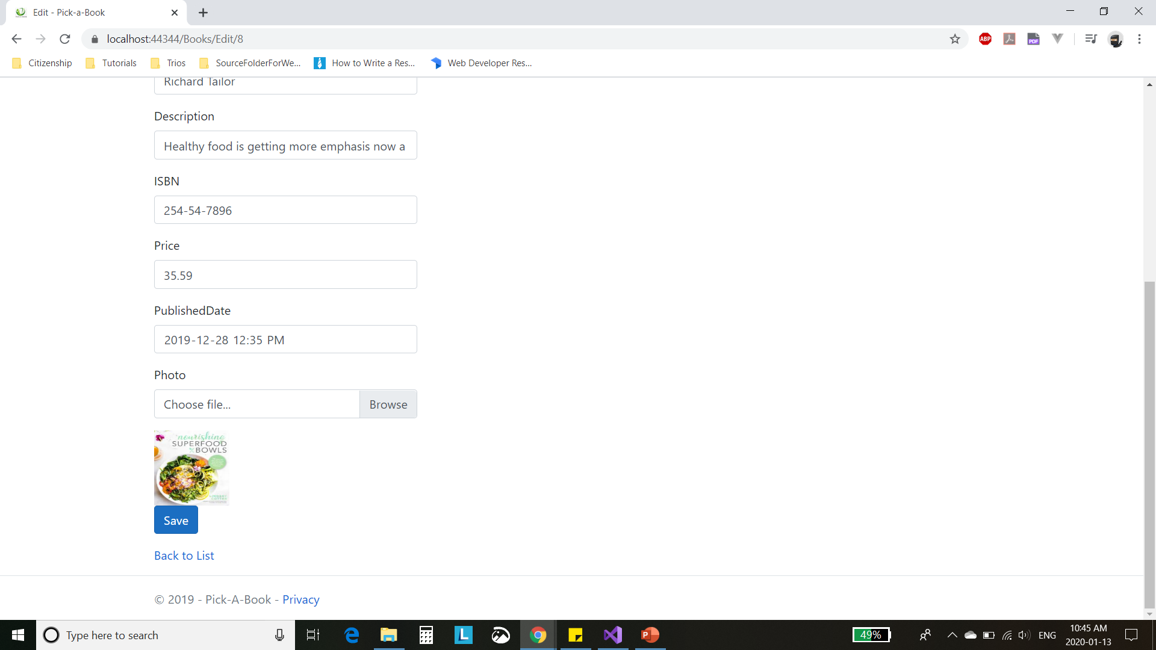
Edit page Second half

Slide 6
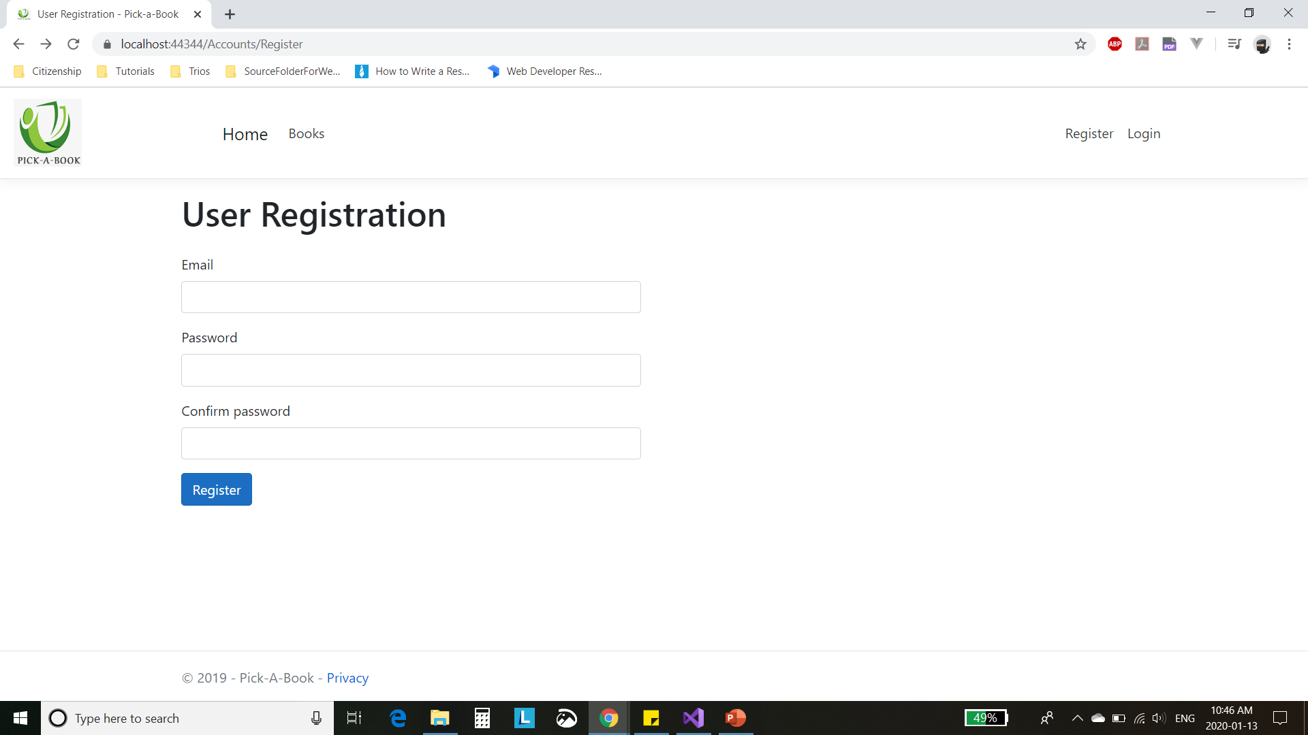
Register page

Slide 7
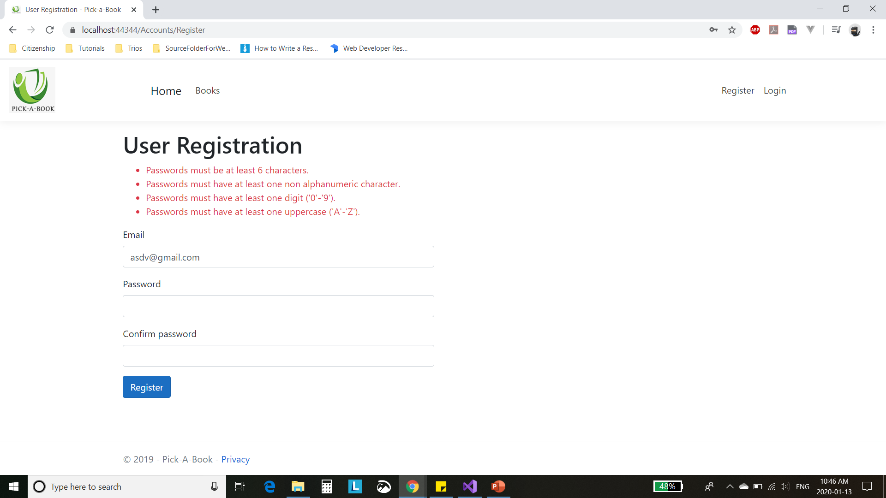
Credentials verification

Slide 8
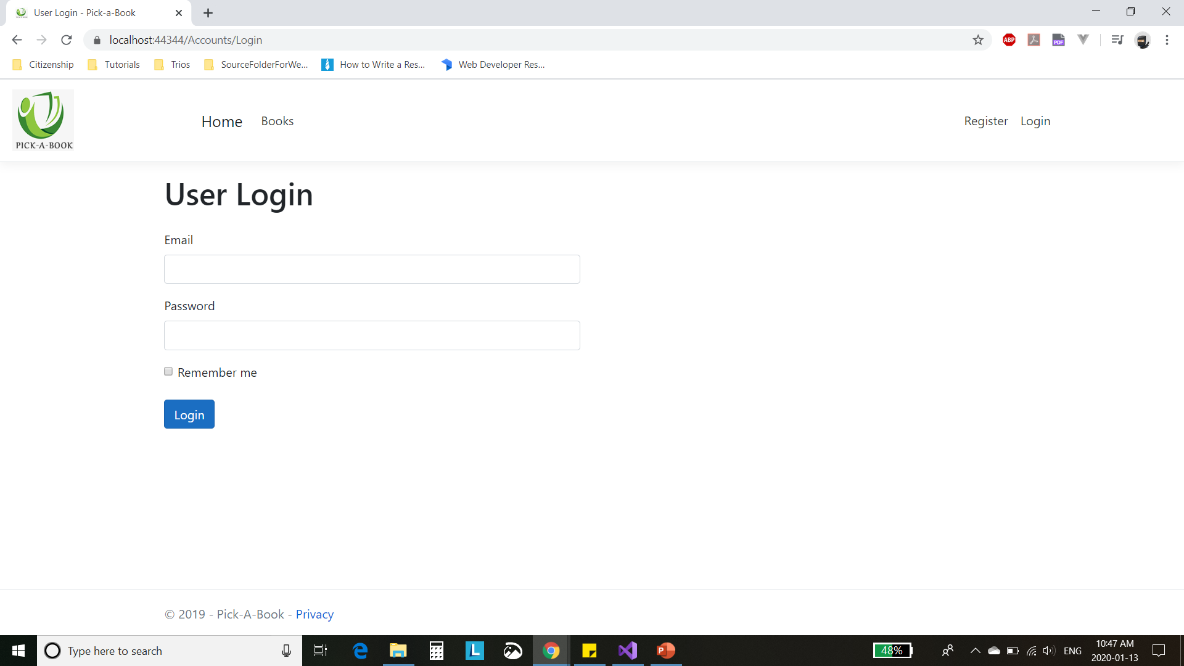
Login page

Slide 9
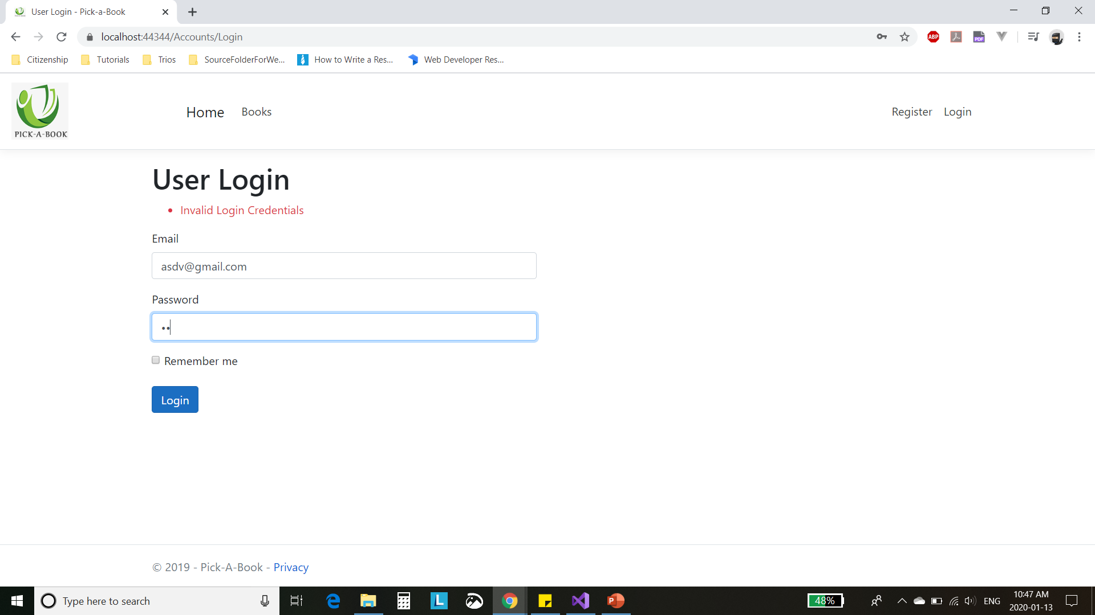
Credentials verification

Slide 10

Logout link
Home page after user has logged in

