Slide 1



Pick-a-Book
We Lose Ourselves in Books, We Find Ourselves There, Too....

Slide 2
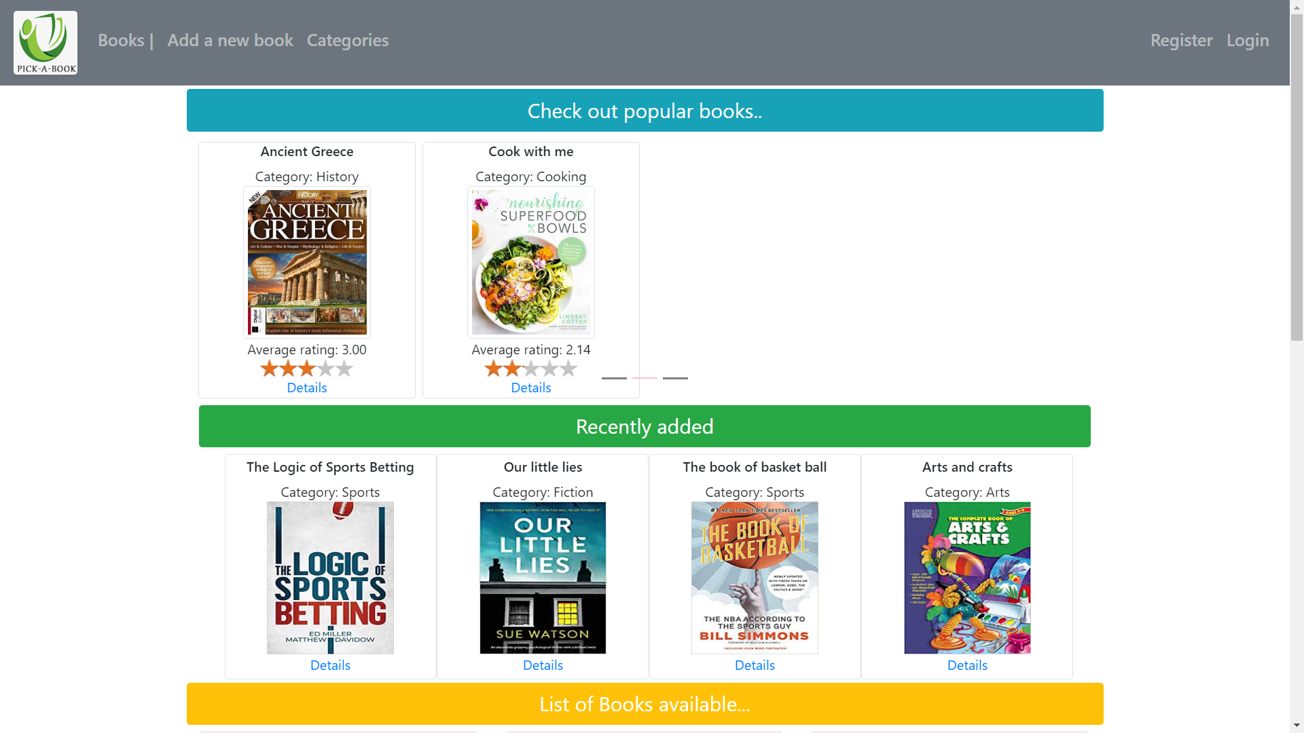
Home page
Carousel for popular books based on ratings
Latest books added display

Slide 3
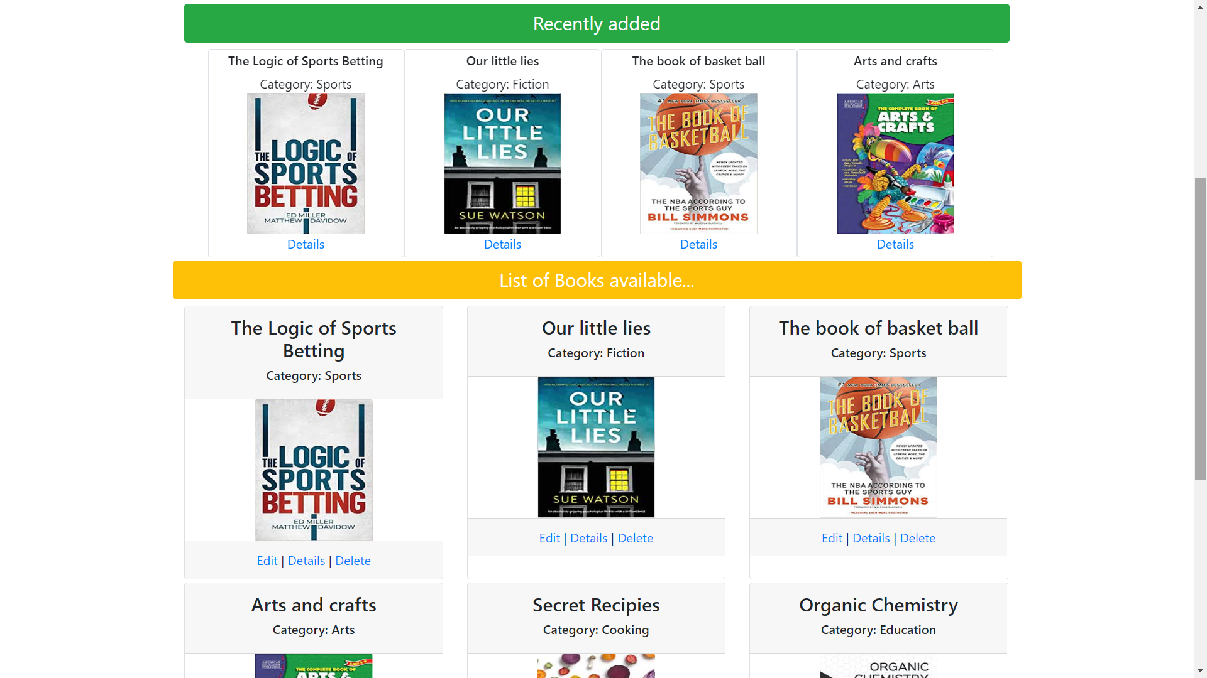
Whole list of books available in book store

Slide 4
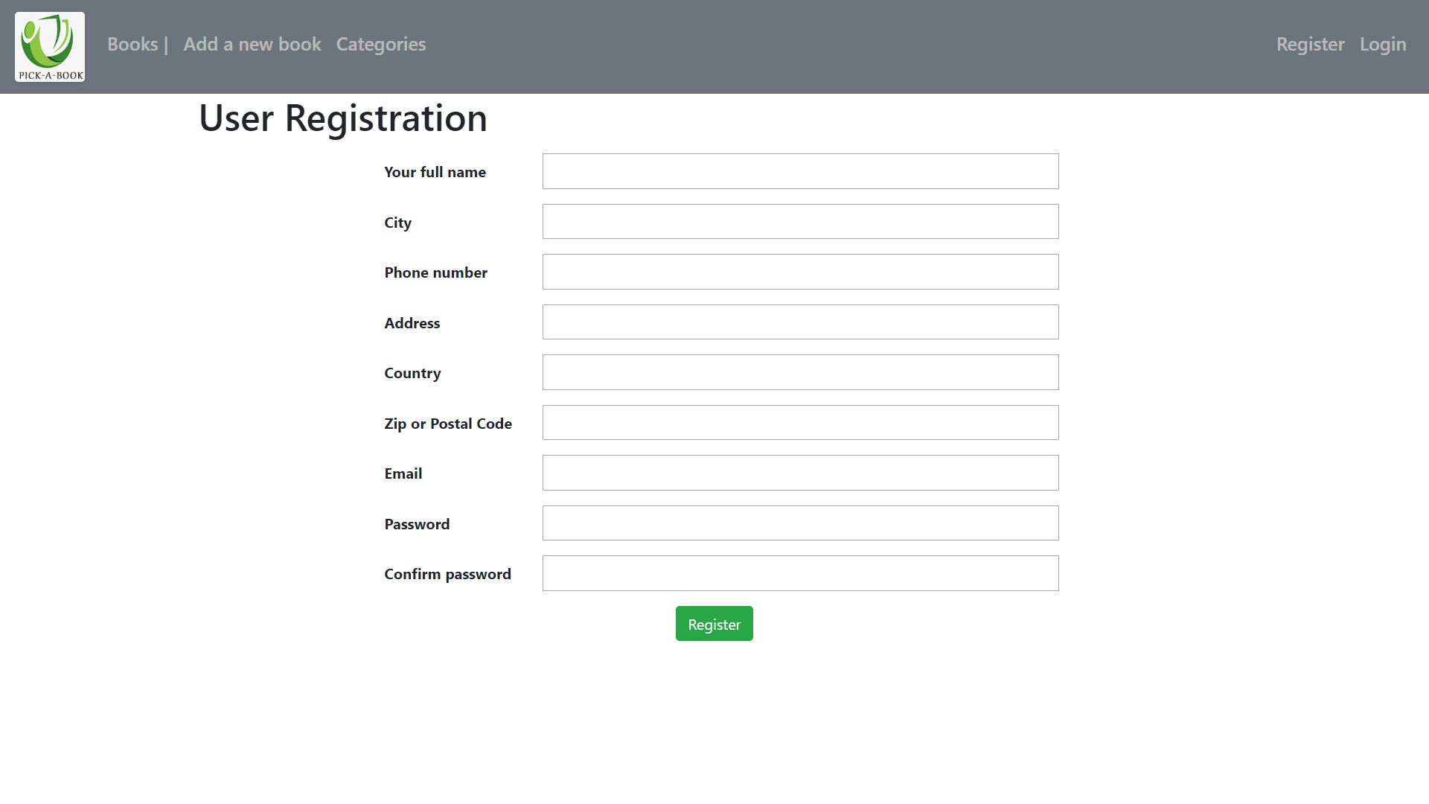
Registration page for new user
To edit, delete and write a review user has to register first

Slide 5
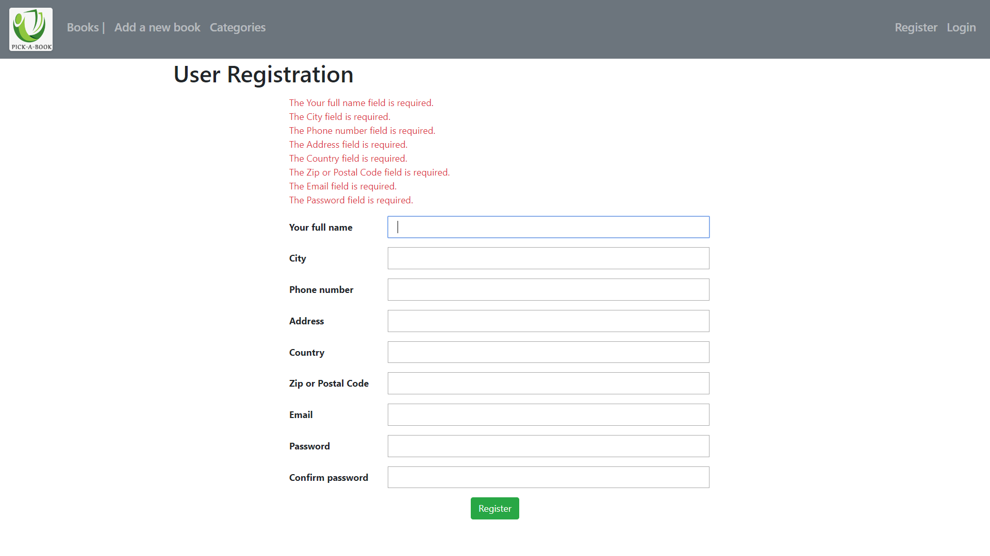
Error message

Slide 6
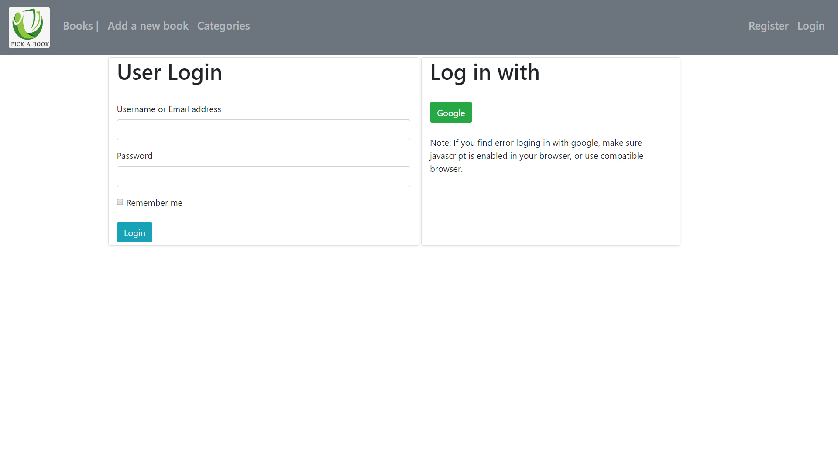
Returning users can login using their log in credentials or google sign in

Slide 7
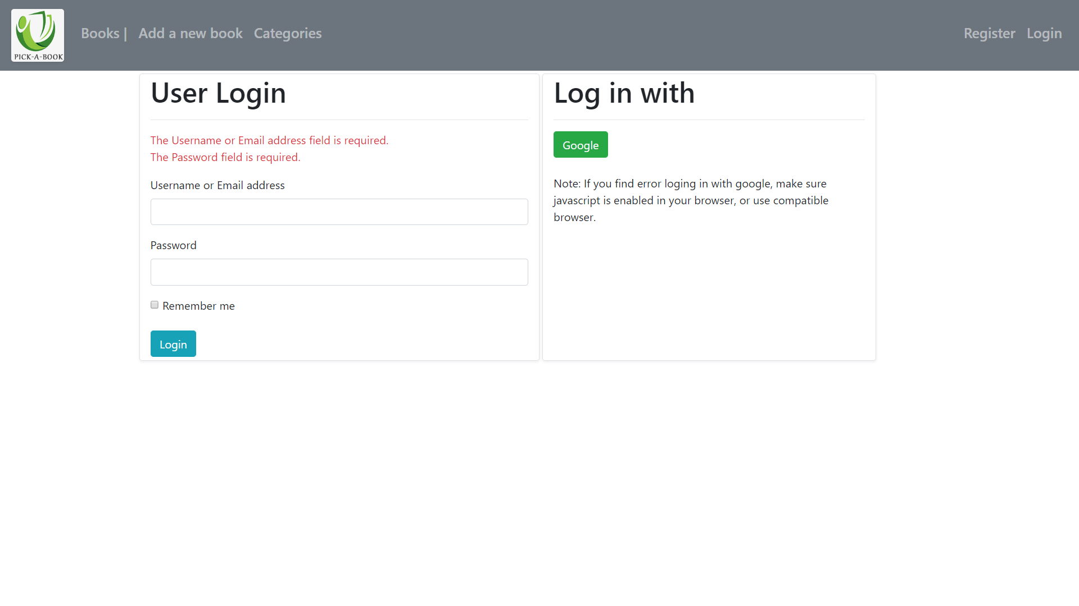
Error message display

Slide 8
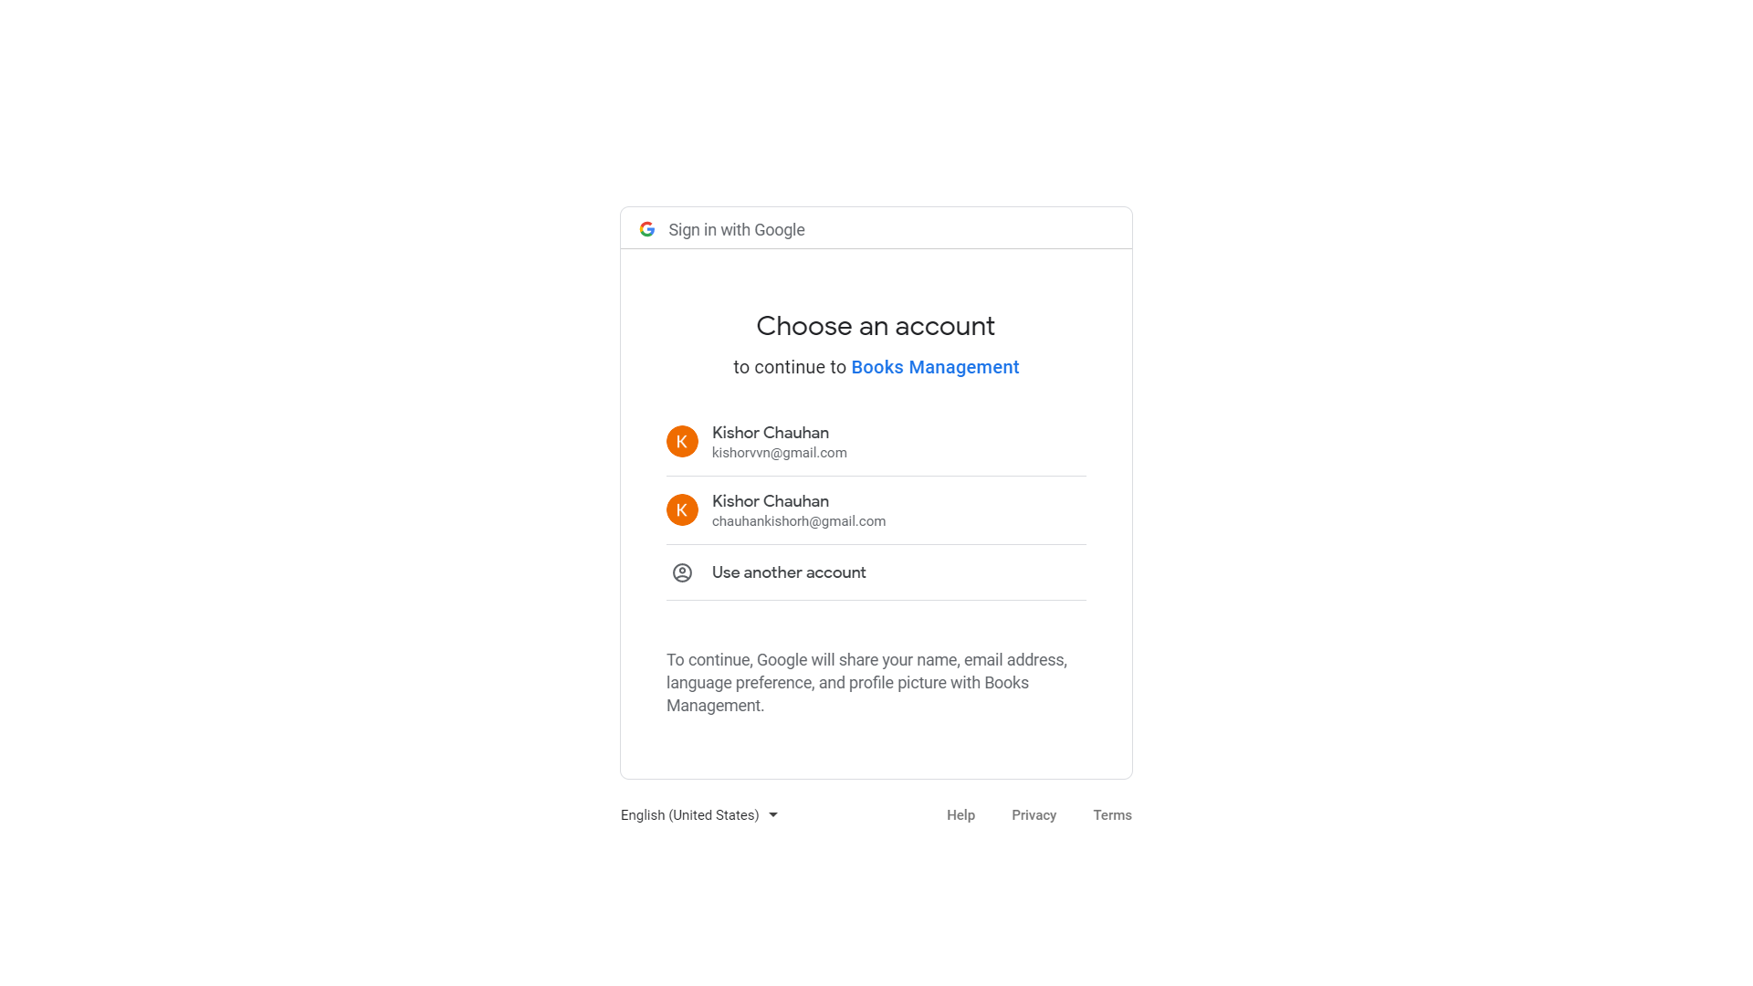
Google sign in page

Slide 9
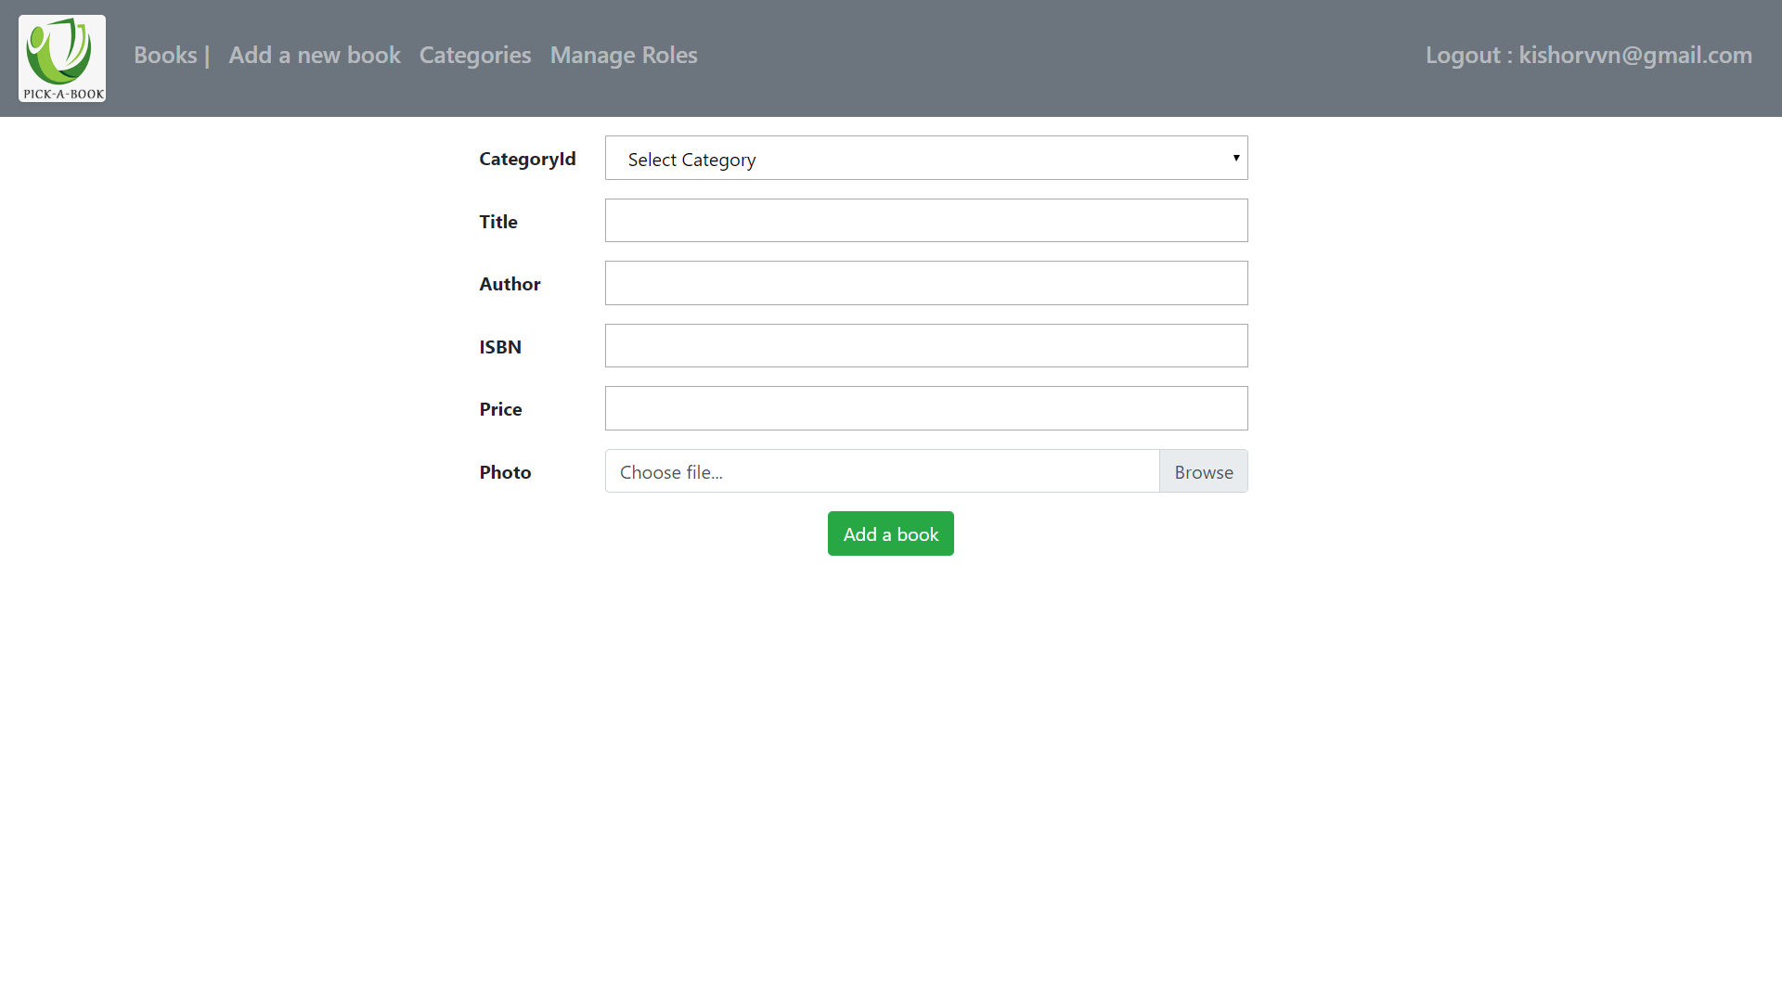
Page for adding a new book

Slide 10
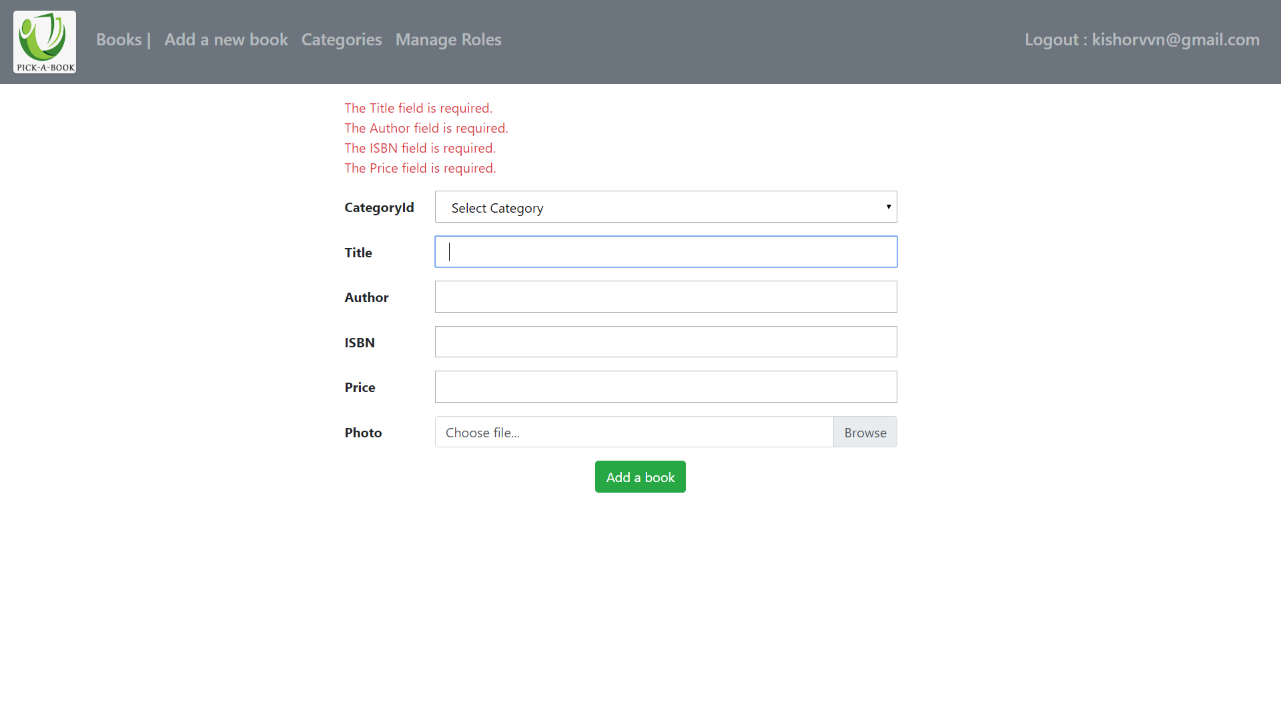
Error message

Slide 11
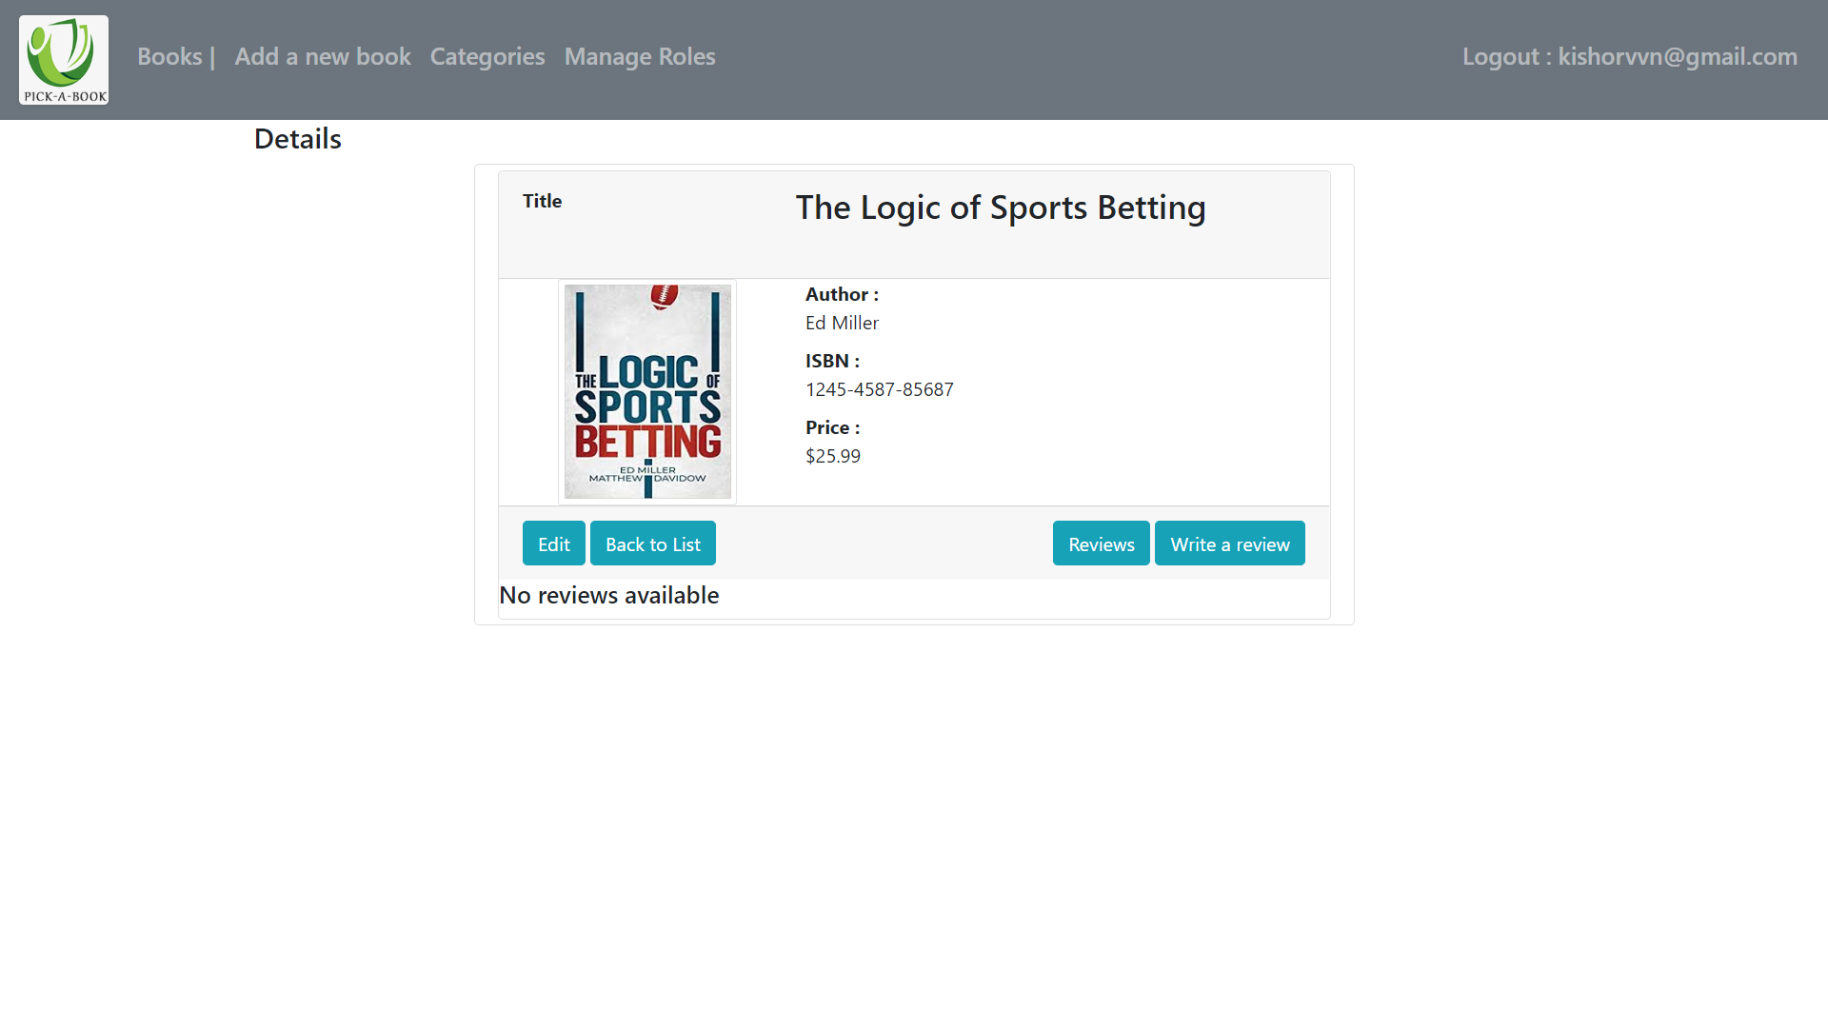
After adding a new book, user is redirected to the detail page of the added book

Slide 12
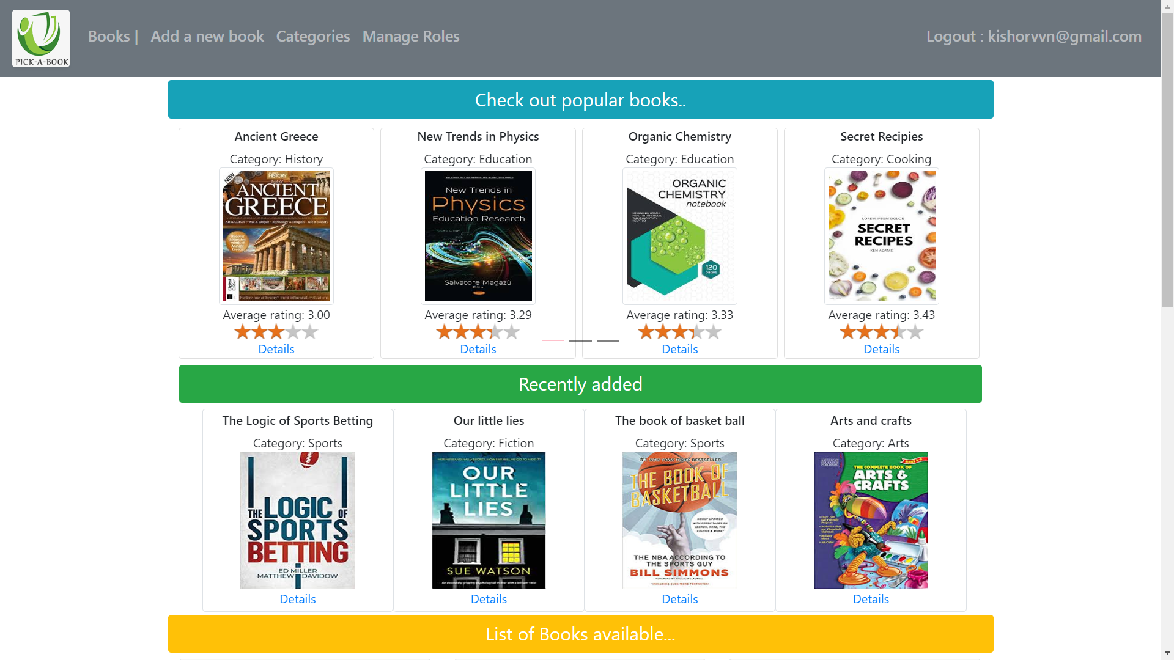
When back to the list button is clicked, home page is displayed

Slide 13
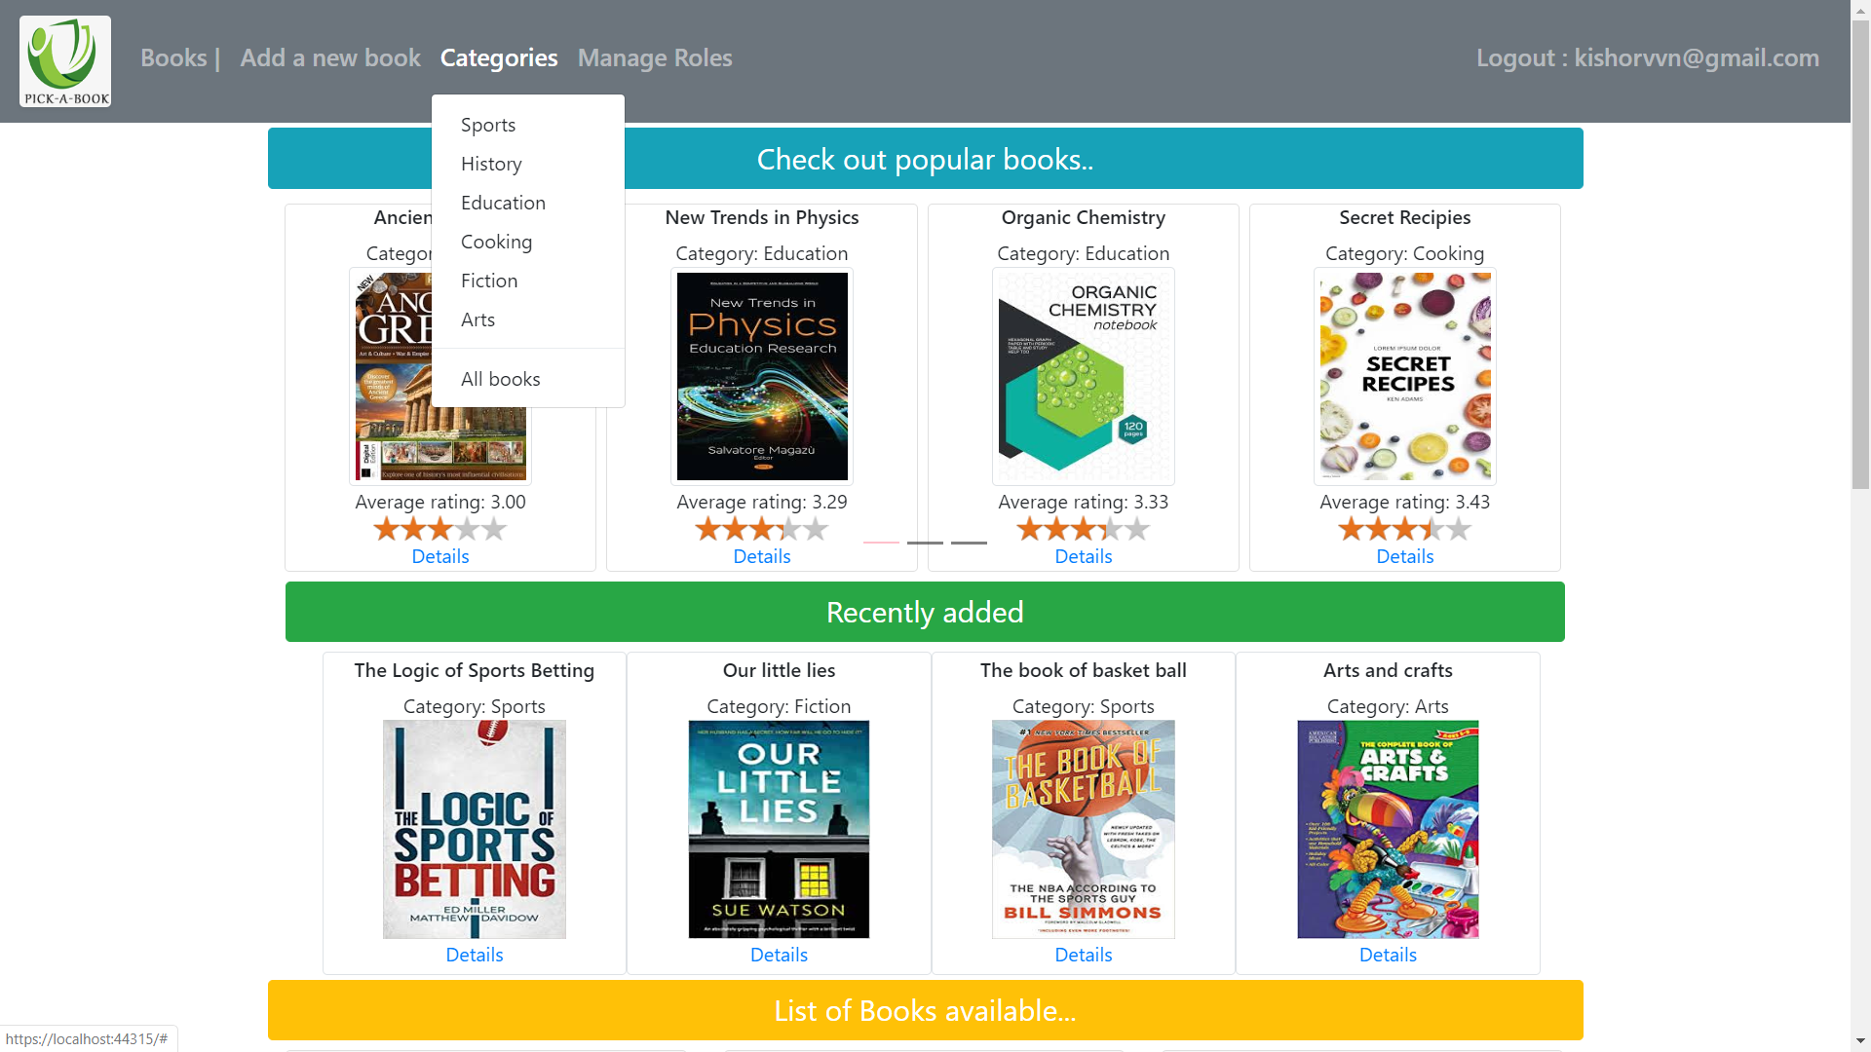
Link to see the books by categories

Slide 14
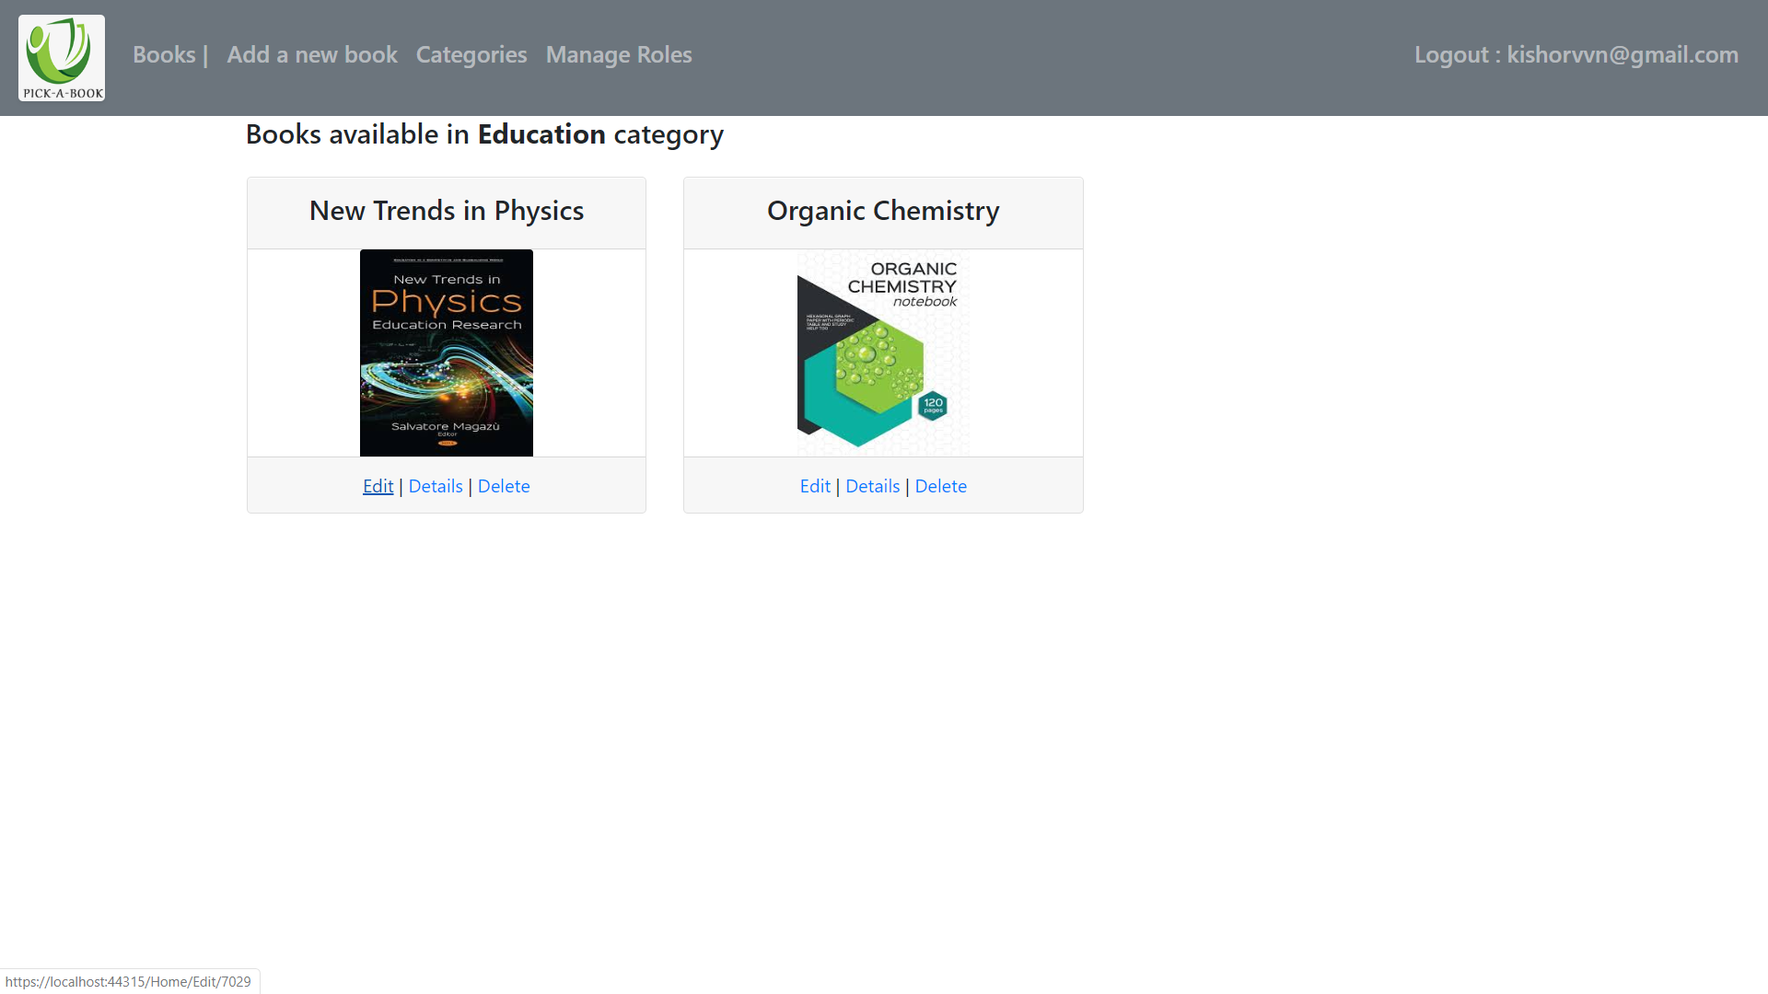
Books by category is displayed

Slide 15
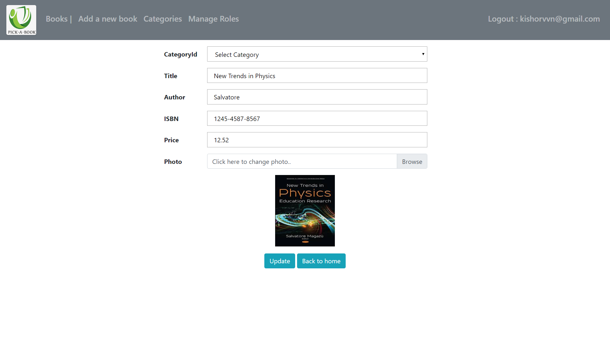
Edit book page displayed when edit button is clicked

Slide 16
After editing and clicking update button, user is redirected to main page

Slide 17

If user is in Admin role, Manage roles navbar link is displayed.

Slide 18
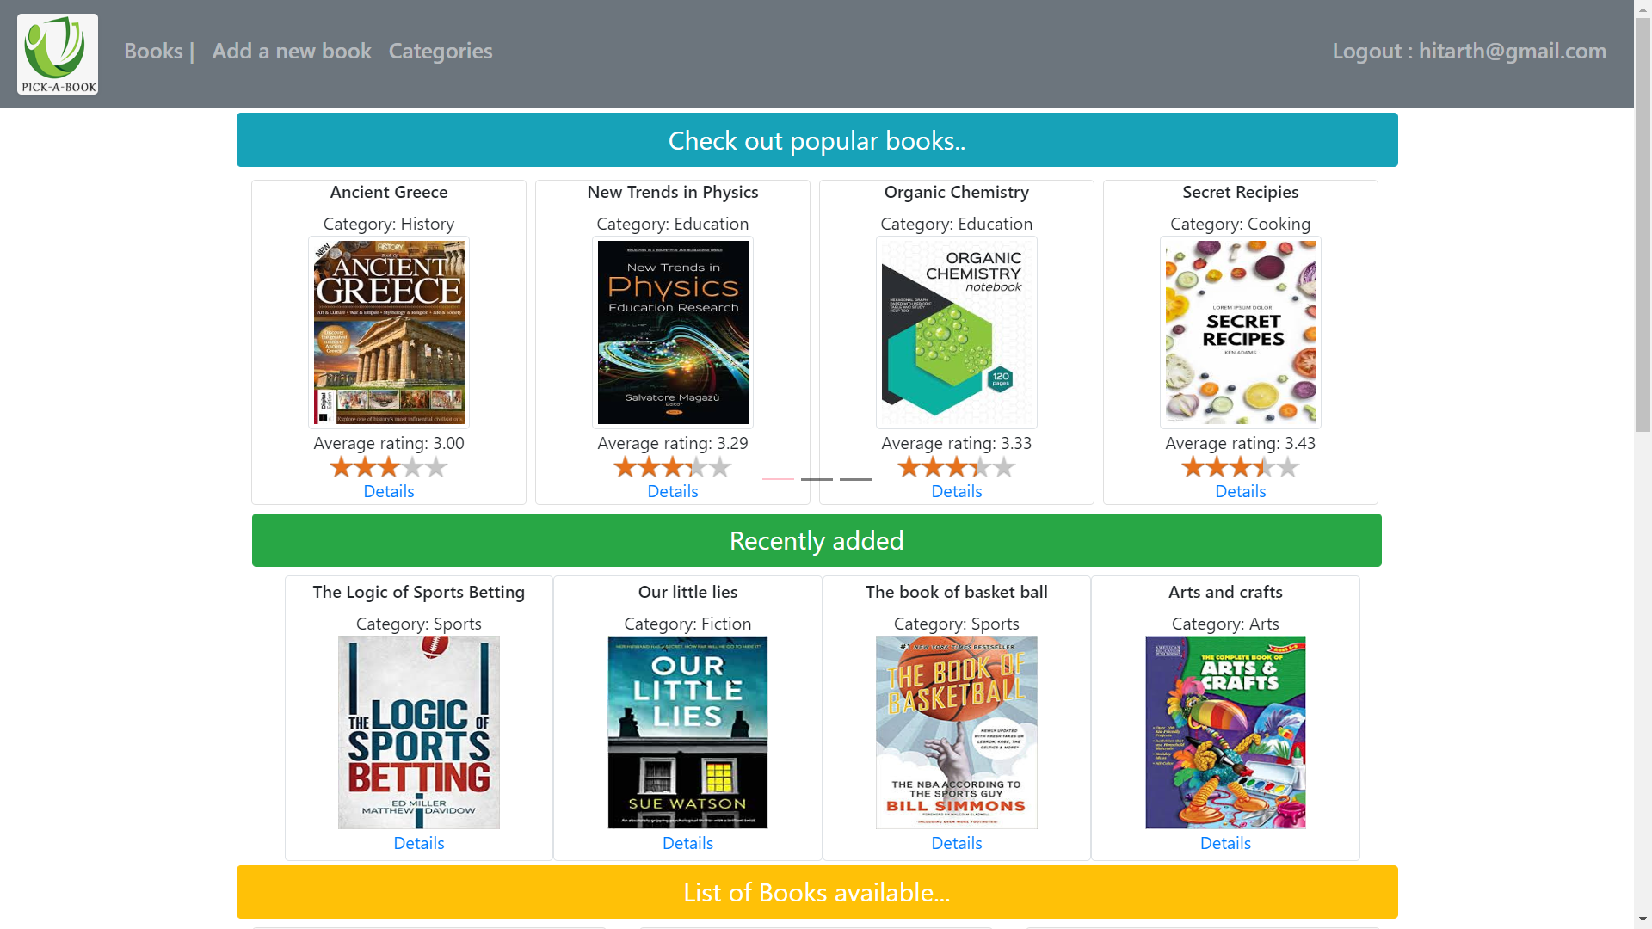
If user is not in Admin role, Manage roles navbar link is displayed.

Slide 19
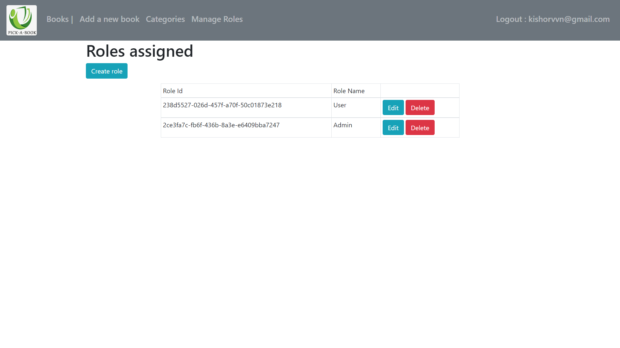
Page for managing roles

Slide 20
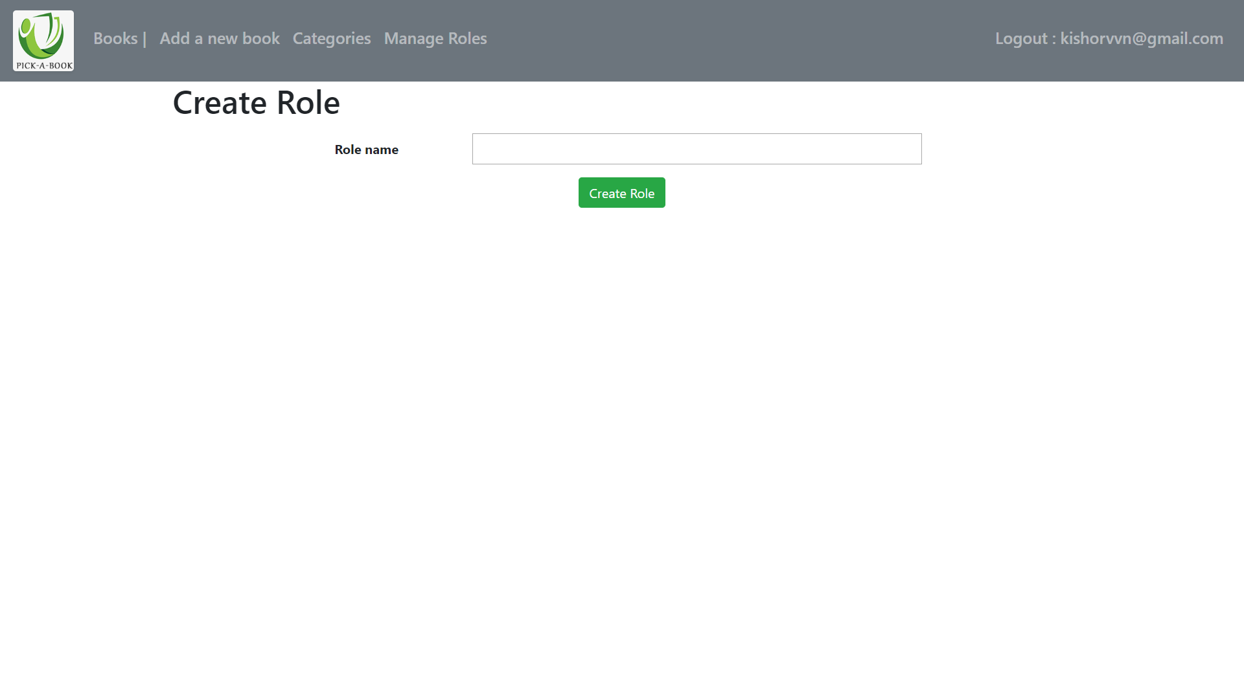
Page for creating roles

Slide 21
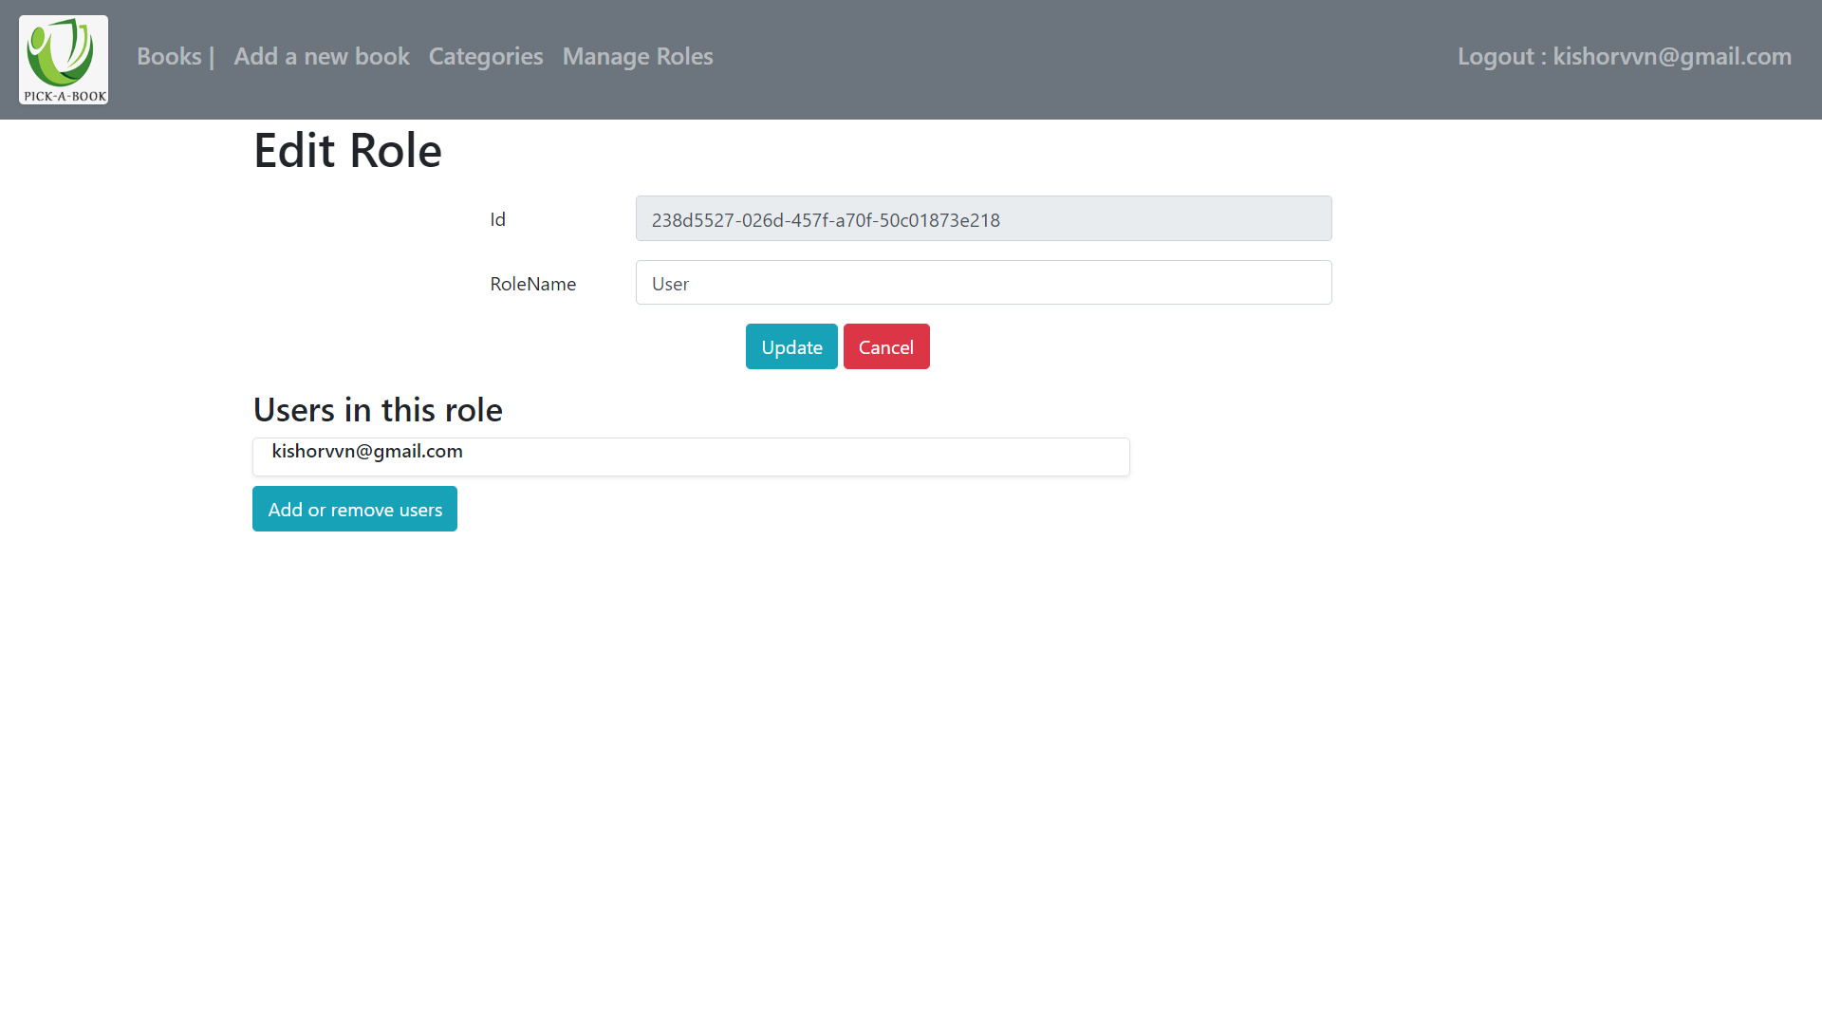
Page for editng roles

Slide 22
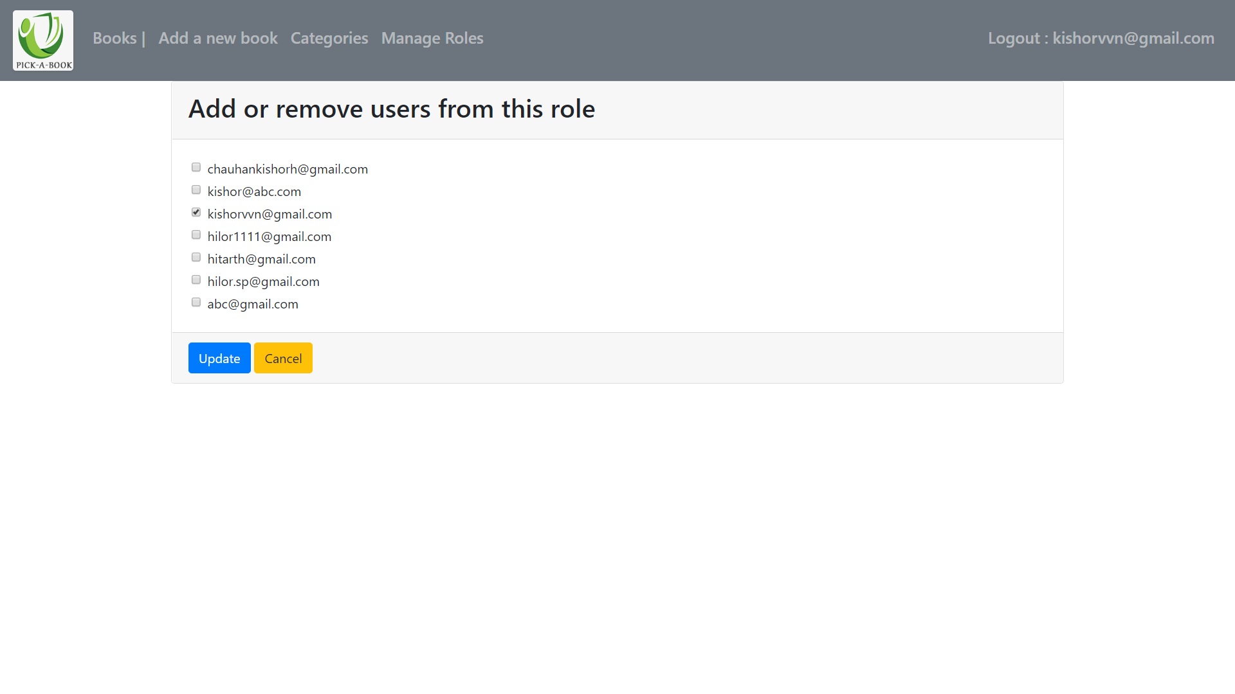
Page for adding or removing users in roles

